Slide 1
Samsung
Innovation
Campus
Artificial Intelligence Course

Slide 2
Chapter 8.
Neural Network and Deep Learning
AI Course

Slide 3
Chapter Description
Chapter objectives
Build and train the deep neural networks.
Optimize the deep learning neural networks preventing the overfitting and vanishing gradient problems.
Gain proficiency with deep learning libraries such as TensorFlow and Keras.
Chapter contents
Unit 1. Basics of Neural Network
Unit 2. Basics of TensorFlow
Unit 3. Deep Learning Methods with TensorFlow and Keras

Slide 4
Unit 1.
Basics of Neural Network
1.1. Understanding Perceptron with Excel
1.2. Understanding Multilayer Perceptron with Excel
1.3. From Multilayer Perceptron to Deep Learning
1.4. Error Backpropagation and Gradient Descent to Reduce Errors
1.5. Activation Function
1.6. Deep Learning
1.7. Problems with Deep Learning and the Solutions

Slide 5
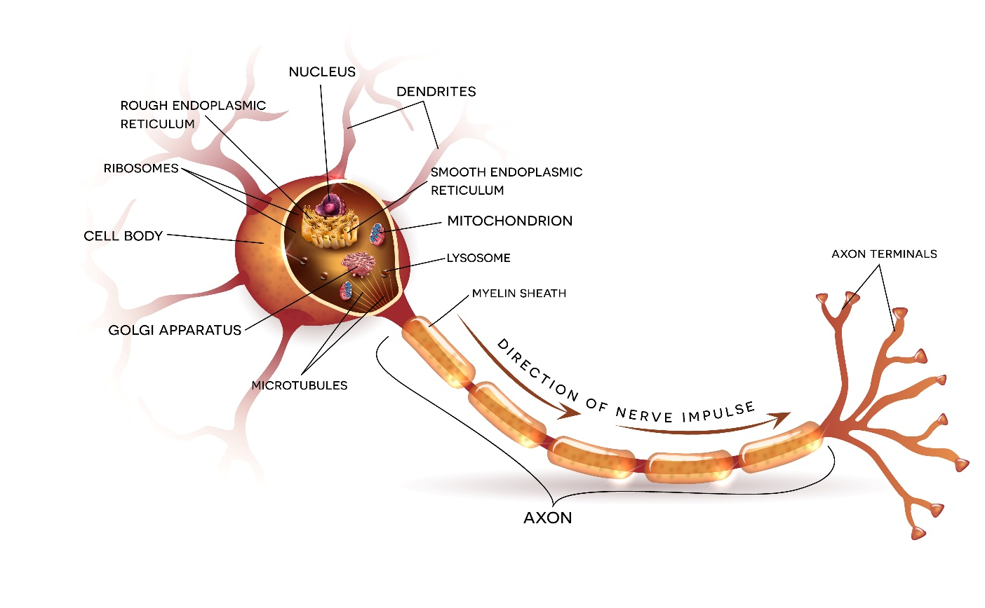
1.1. Understanding Perceptron with Excel
UNIT 01
Overview
Biological origin
Human neuron is the smallest information processing unit that composes the neural system. It consists of a cell body, dendrites, and an axon.
A cell body transmits simple operations, a dendrite transmits received signals, and an axon transmits the executed results.
Notes:
The picture is taken from https://en.wikipedia.org/wiki/Neuron
Here, we have the diagram of an actual biological neuron.
A neuron is essentially a trigger mechanism that fires when enough input signals accumulate.
Human brain has lots of these neurons, numbering in tens of billions.
Neurons upon neurons form an interdependent network where signals can traverse.

Slide 6

1.1. Understanding Perceptron with Excel
UNIT 01
Overview
Biological origin
They receive and store various information by exchanging chemical signals with adjacent neurons through a structure named synapse.
The number of neurons in the brain of a human being is about 1011 neurons. And the average neuron has around 1,000 synapses. Thus, 100 trillion (1014) synapses are interconnected in the human brain.
In the 1940s, several researchers who studied biological neural networks began to investigate how to emulate the mechanisms of the neural network. Perceptron is one of the early artificial neural network models.
From here on, the term ‘neural network’ refers to an ‘artificial’ neural network.
Notes:
The picture is taken from https://en.wikipedia.org/wiki/Neuron
Here, we have the diagram of an actual biological neuron.
A neuron is essentially a trigger mechanism that fires when enough input signals accumulate.
Human brain has lots of these neurons, numbering in tens of billions.
Neurons upon neurons form an interdependent network where signals can traverse.

Slide 7
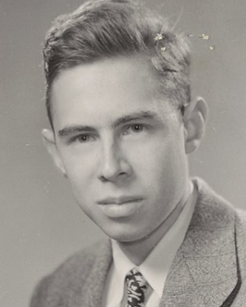
1.1. Understanding Perceptron with Excel
UNIT 01
History of Neural Network
In 1943, McCulloch and Pitts first delineated the working mechanisms of neurons.
Rosenblatt’s perceptron is based on McCulloch Pitts neuron model.
In 1958, Rosenblatt first proposed perceptron.
In 1969, Minsky and Papert mathematically proved the limitations of the perceptron in their book 『Perceptrons』. It was found that a perceptron could not solve the XOR problem because it was only a linear classifier.
Frank Rosenblatt
(1928~1971)

Slide 8
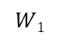
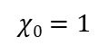
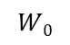
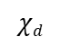
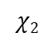
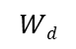
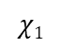
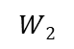
1.1. Understanding Perceptron with Excel
UNIT 01
Perceptron
The Structure of a Perceptron
Input
Output
$$χ0=1$$
$$χ1$$
$$W0$$
$$W1$$
$$χ2$$
$$W2$$
y
$$Wd$$
$$χd$$
Structure of a perceptron
Comprehend the structure of a perceptron by solving the OR function of the truth table.

Slide 9
1.1. Understanding Perceptron with Excel
UNIT 01
Perceptron
First, you need to understand the OR operation of the truth table. The results of the OR operation are as below.
X1 | X2 | OR operation
False | False | F
True | False | T
False | True | T
True | True | T
What are the weight values to solve the OR operation problem?

Slide 10
1.1. Understanding Perceptron with Excel
UNIT 01
Perceptron
Suppose that we know the ‘w’ values to solve a problem. w0 is -0,5, w1 is 1, w2 is 1.
(w: a weight vector)
Execute the Excel function after substituting x1 with 0 and x2 with 0.
x1 | X2
0 | 0
w0 | w1 | w2
-0.5 | 1 | 1
1
1
x0
w0
x0 * w0 | -0.5
-0.5
+
x1
0
0
w1
x0 * w1 | 0
+
x0 * w2 | 0
w2
Sum | -0.5
x2
0
0
Notes:
Put different values in Excel and check the results.

Slide 11
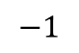

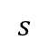
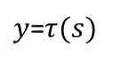
1.1. Understanding Perceptron with Excel
UNIT 01
Perceptron
Put the value of the sum into a function.
Here, that function is the step function.
$y$=$τ(s)$
$$1$$
$$s$$
$$−1$$
Use a threshold function as an activation function $τ$(s).

Slide 12
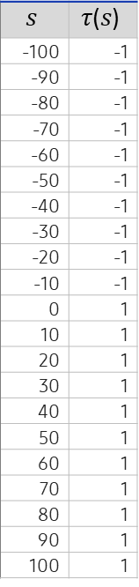
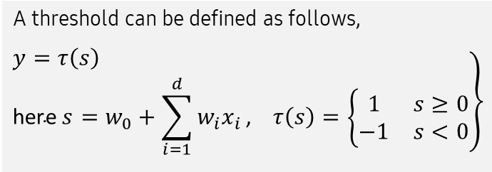
1.1. Understanding Perceptron with Excel
UNIT 01
Perceptron
A threshold function can be defined as follows, and we can create a graph by putting random values in the Excel table.
A threshold can be defined as follows,
$$\left.\begin{aligned}y=τ\left(s\right) \\ \text{here} s=w_{0}+\sum_{i=1}^{d}{w_{i}x_{i}}\text{, }τ\left(s\right)=\left\{\begin{matrix}1 & s≥0 \\ −1 & s<0\end{matrix}\right.\end{aligned}\right\}$$
$$s$$ | $$τ\text{(}s\text{)}$$
-100 | -1
-90 | -1
-80 | -1
-70 | -1
-60 | -1
-50 | -1
-40 | -1
-30 | -1
-20 | -1
-10 | -1
0 | 1
10 | 1
20 | 1
30 | 1
40 | 1
50 | 1
60 | 1
70 | 1
80 | 1
90 | 1
100 | 1
Threshold function
1.5
Here,
1.0
0.5
-150
-100
-50
0
0
50
100
150
-0.5
-1
-1.5
Notes:
Put different values in Excel and denote them in a graph. This will help understanding the threshold function.

Slide 13
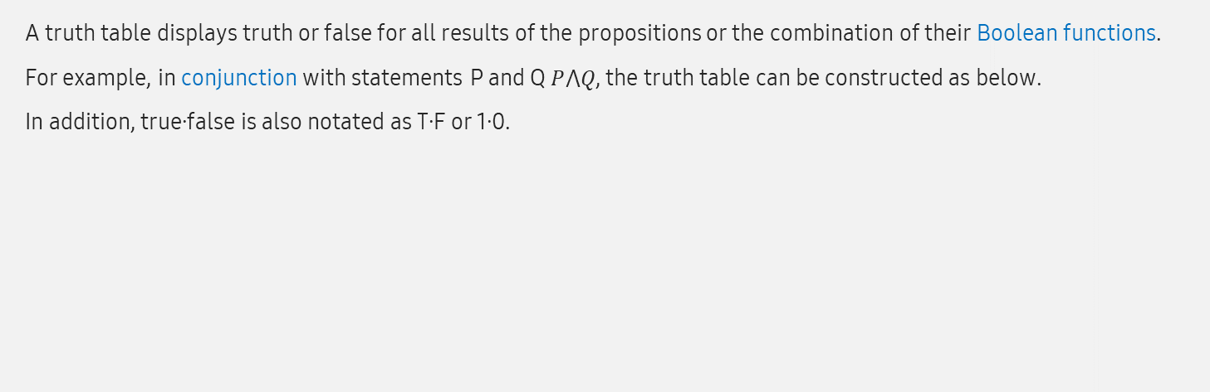
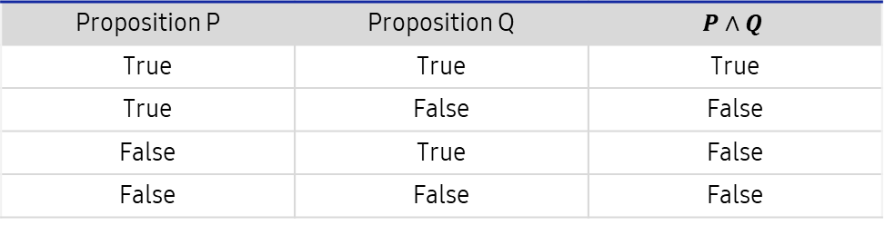
1.1. Understanding Perceptron with Excel
UNIT 01
Perceptron
Put the result from the previous slide, -0.5 as s, and run it through the threshold function. The return is -1.
Let’s learn about the truth table.
A truth table displays truth or false for all results of the propositions or the combination of their Boolean functions.
For example, in conjunction with statements P and Q $P⋀Q$, the truth table can be constructed as below.
In addition, true∙false is also notated as T∙F or 1∙0.
Proposition P | Proposition Q | $$P∧Q$$
True | True | True
True | False | False
False | True | False
False | False | False

Slide 14
1.1. Understanding Perceptron with Excel
UNIT 01
Perceptron
A truth table can be expressed with 1 and 0 as follows.
The figure from Slide 9 puts 0 for the first variable x1 and 0 for x2 as well.
x0 is called a bias, and it initializes as 1.
x1 | x2
0 | 0
1 | 0
0 | 1
1 | 1

Slide 15
1.1. Understanding Perceptron with Excel
UNIT 01
Perceptron
Substitute x1 with 1 and x2 with 0.
The bias is generally fixed as 1.
x0(bias)
1
1
w0
x0*w0
-0.5
+
0
w1
-0.5
x1
1
x1*w1
1
+
w2
x2*w2
0
x2
0
0
Sum
0.5
Notes:
In the previous slide, we supposed that we know the w value of the solution. w0 is =0.5, w1 is 1, w2 is 1.

Slide 16
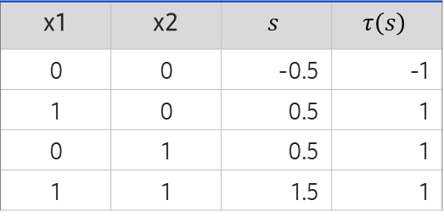
1.1. Understanding Perceptron with Excel
UNIT 01
Perceptron
The sum is 0.5. Run this through the threshold function, and the result is 1.
Likewise, if we process all values in the truth table through the perceptron, the results are as follows.
The bias is generally fixed as 1.
4 results can be displayed in a table.
x0(bias)
1
x1 | x2 | $$s$$ | $$τ\left(s\right)$$
0 | 0 | -0.5 | -1
1 | 0 | 0.5 | 1
0 | 1 | 0.5 | 1
1 | 1 | 1.5 | 1
w0
x0*w0
-0.5
+
w1
-0.5
x1
1
x1*w1
1
+
w2
x2*w2
1
x2
1
Sum
1.5

Slide 17
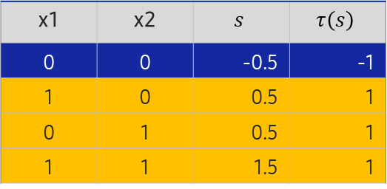
1.1. Understanding Perceptron with Excel
UNIT 01
Perceptron
These results can be shown in the coordinate plane as follows.
The results can be grouped into that of point (0,0) or the rest.
x1 | x2 | $$s$$ | $$τ\left(s\right)$$
0 | 0 | -0.5 | -1
1 | 0 | 0.5 | 1
0 | 1 | 0.5 | 1
1 | 1 | 1.5 | 1
(0,1)
(1.1)
(0,0)
(1.0)

Slide 18
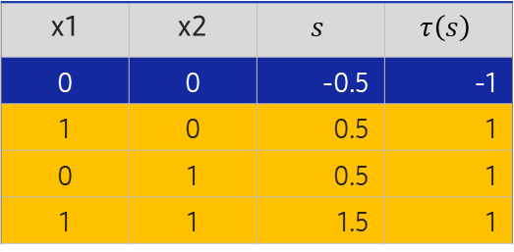
1.1. Understanding Perceptron with Excel
UNIT 01
Perceptron
Such classification can be presented as a geometrical figure as follows.
If you recall the basic notion of machine learning through linear regression, machine learning is a process that builds regression equations with the predicted values of the slope and y-intercept. The figure below shows how linear regression forms a line that separates the two groups.
x1 | x2 | $$s$$ | $$τ\left(s\right)$$
0 | 0 | -0.5 | -1
1 | 0 | 0.5 | 1
0 | 1 | 0.5 | 1
1 | 1 | 1.5 | 1
(0,1)
(1.1)
This table displays the OR operation of a truth table.
(0,0)
(1.0)

Slide 19
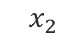
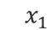
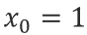
1.1. Understanding Perceptron with Excel
UNIT 01
OR operation
x1 | x1 | x2 | Value before running threshold function | Value after running threshold function
0 | 0 | 0 | =$A$2*$C$7+B2*$C$8+C2*$C$9 | =IF(D2>=0,1,-1)
 | 0 | 1 | =$A$2*$C$7+B3*$C$8+C3*$C$9 | =IF(D3>=0,1,-1)
 | 1 | 0 | =$A$2*$C$7+B4*$C$8+C4*$C$9 | =IF(D4>=0,1,-1)
 | 1 | 1 | =$A$2*$C$7+B8*$C$8+C5*$C$9 | =IF(D5>=0,1,-1)
w1 | -0.5
w2 | 1
w3 | 1
$$x_{1}=\left(\begin{matrix}0 \\ 0\end{matrix}\right) , y_{1}=−1 , x_{2}=\left(\begin{matrix}1 \\ 0\end{matrix}\right) ,y_{2}=1 ,x_{3}=\left(\begin{matrix}0 \\ 1\end{matrix}\right) ,y_{3}=1 ,x_{4}=\left(\begin{matrix}1 \\ 1\end{matrix}\right) ,y_{4}=1$$
$$x_{2}$$
$$x_{0}=1$$
$$x_{3}$$
$$x_{4}$$
-0.5
$$x_{1}$$
1.0
$$y$$
$$x_{1}$$
$$x_{2}$$
1.0
$$x_{1}$$
$$x_{2}$$
(a) Train set
(b) Perceptron
Example of a perceptron’s operation using the OR logic gate

Slide 20
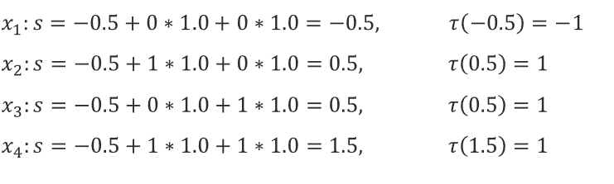
1.1. Understanding Perceptron with Excel
UNIT 01
OR operation
Let’s input four samples to the perceptron and check the results.
$$x_{1}:s=−0.5+0∗1.0+0∗1.0=−0.5, τ\left(−0.5\right)=−1$$
$$x_{2}:s=−0.5+1∗1.0+0∗1.0=0.5, τ\left(0.5\right)=1$$
$$x_{3}:s=−0.5+0∗1.0+1∗1.0=0.5, τ\left(0.5\right)=1$$
$$x_{4}:s=−0.5+1∗1.0+1∗1.0=1.5, τ\left(1.5\right)=1$$
As you’ve seen in the previous slide, the perceptron delivered correct results for all four samples.
It can be said that this perceptron classifies the train set with 100% performance.
Notes:
AND operation could be done in the same way.

Slide 21
1.1. Understanding Perceptron with Excel
UNIT 01
AND operation
To recap, you can solve the OR problem by perceptron with the appropriate w values.
Now, the AND operation. The truth table is on the left, and the geometrical solution is the line that separates the units into two groups.
x1 | x2 | AND operation
0 | 0 | F
1 | 0 | F
0 | 1 | F
1 | 1 | T
(0,1)
(1.1)
(0,0)
(1.0)

Slide 22
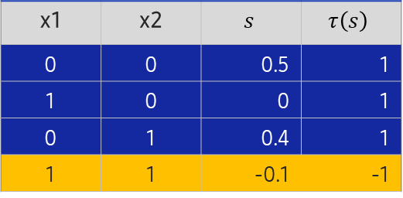
1.1. Understanding Perceptron with Excel
UNIT 01
AND operation
Find the values of w0, w1, and w2 that return the result from the previous slide.
First, let’s apply a random value, and then gradually change the values of w0, w1, and w2 to find the solution.
The bias is generally fixed as 1.
4 results can be displayed in a table.
x0(bias)
1
x1 | x2 | $$s$$ | $$τ\left(s\right)$$
0 | 0 | 0.5 | 1
1 | 0 | 0 | 1
0 | 1 | 0.4 | 1
1 | 1 | -0.1 | -1
w0
0.5
x0*w0
0.5
+
w1
-0.5
-0.5
x1
1
x1*w1
-0.5
+
AND operation of a truth table
w2
-0.1
x2*w2
-0.1
x2
1
Sum
-0.1

Slide 23
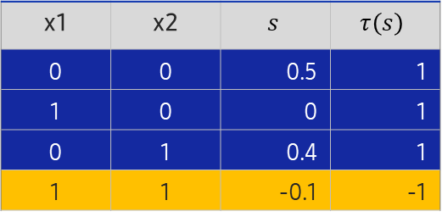
1.1. Understanding Perceptron with Excel
UNIT 01
AND operation
The bias is generally fixed as 1.
4 results can be displayed in a table.
x0(bias)
1
x1 | x2 | $$s$$ | $$τ\left(s\right)$$
0 | 0 | 0.5 | 1
1 | 0 | 0 | 1
0 | 1 | 0.4 | 1
1 | 1 | -0.1 | -1
w0
0.5
x0*w0
0.5
+
w1
-0.5
-0.5
x1
1
x1*w1
-0.5
+
AND operation of a truth table
w2
-0.1
x2*w2
-0.1
x2
1
Sum
-0.1
By substituting w0 with 0.5, w1 with -0.5, and w2 with -0.1, the equation solves the AND operation.
You found that a structure with appropriate values for the w vector solves a certain problem.
Although the perceptron solved the OR and AND problems, it could not solve the XOR. Let’s find out why.

Slide 24
1.1. Understanding Perceptron with Excel
UNIT 01
XOR operation
XOR operation in a truth table
In XOR, the result is true if two propositions are the opposite.
Since the perceptron is a linear classifier, you cannot find a line separating the blue and red dots.
A multilayer perceptron solved the problem.
x1 | x2 | XOR Operation
0 | 0 | F
1 | 0 | T
0 | 1 | T
1 | 1 | F
(0,1)
(1.1)
(0,0)
(1.0)

Slide 25
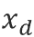
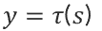
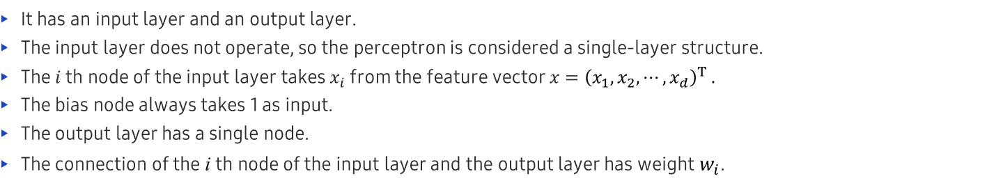
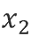

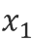
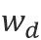
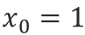
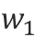
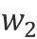
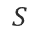
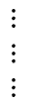
1.1. Understanding Perceptron with Excel
UNIT 01
Summary of Perceptron’s Structure
It has an input layer and an output layer.
The input layer does not operate, so the perceptron is considered a single-layer structure.
The $i$ th node of the input layer takes $x_{i}$ from the feature vector $x={\left(x_{1},x_{2},⋯,x_{d}\right)}^{T} .$
The bias node always takes 1 as input.
The output layer has a single node.
The connection of the i th node of the input layer and the output layer has weight $w_{i}$.
Input
Output
$$y=τ\text{(}s\text{)}$$
$$x_{0}=1$$
$$x_{1}$$
$$w_{0}$$
1
$$w_{1}$$
$$x_{2}$$
$$w_{2}$$
$$y$$
$$S$$
$$⋮ \\ ⋮$$
$$⋮$$
$$w_{d}$$
-1
$$x_{d}$$
(a) Structure of a perceptron
(b) Use threshold function as an activation function $τ$(s)
Mechanism of a perceptron
Notes:
Perceptron introduced new terms such as node, weight, layer and invented learning algorithm.
Perceptron is a primitive neural network, but the modern neural network including deep learning was created by combining perceptron in serial and parallel structures. Therefore, the perceptron is an important component of modern neural networks.

Slide 26
Unit 1.
Basics of Neural Network
1.1. Understanding Perceptron with Excel
1.2. Understanding Multilayer Perceptron with Excel
1.3. From Multilayer Perceptron to Deep Learning
1.4. Error Backpropagation and Gradient Descent to Reduce Errors
1.5. Activation Function
1.6. Deep Learning
1.7. Problems with Deep Learning and the Solutions

Slide 27
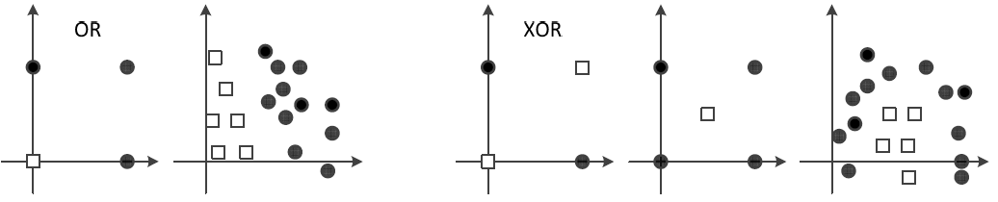
1.2. Understanding Multilayer Perceptron with Excel
UNIT 01
Understand Multilayer Perceptron with Excel
Perceptron cannot compute the XOR function.
Linear classification is impossible, and a certain amount of errors occur.
75% accuracy is the limit in the XOR function.
Linearly separable case and linearly inseparable case
OR
XOR
(a) Linearly separable
(b) Linearly inseparable
Notes:
In XOR, the inputs are not linearly separable.
It could not solve a simple problem like XOR.
This was claimed by Marvin Minsky, an MIT professor who was the pioneer of the AI field, in his book <Perceptrons>, published in 1969.
People realized that emulating the diagram of ‘neuron → neural network → intelligence’ through the diagram of ‘perceptron → artificial neural network → artificial intelligence’ was not an easy task.
After this publication, research on AI took a downturn.
After 10 years, this problem was solved by ‘multilayer’ perceptron.

Slide 28
1.2. Understanding Multilayer Perceptron with Excel
UNIT 01
Multilayer Perceptron
In XOR, the inputs are not linearly separable.
It could not solve a simple problem like XOR.
This was claimed by Marvin Minsky, an MIT professor who was the pioneer of the AI field, in his book <Perceptrons>, published in 1969.
People realized that emulating the diagram of ‘neuron → neural network → intelligence’ through the diagram of ‘perceptron → artificial neural network → artificial intelligence’ was not an easy task.
After this publication, research on AI took a downturn.
After 10 years, this problem was solved by a ‘multilayer’ perceptron.

Slide 29
1.2. Understanding Multilayer Perceptron with Excel
UNIT 01
Multilayer Perceptron
What are the ways you can separate the inputs that are not linearly separable?
First, the inputs can be separated in a non-linear form.
Second, a two-dimensional figure on a plane could be modified into a three-dimensional figure to enable separation.

Slide 30

1.2. Understanding Multilayer Perceptron with Excel
UNIT 01
Solution for the XOR problem
Artificial Intelligence scientists had to overcome the XOR problem to develop an artificial neural network.
An innovative idea provided hints for the solution.
You had to bend the plane!

Slide 31
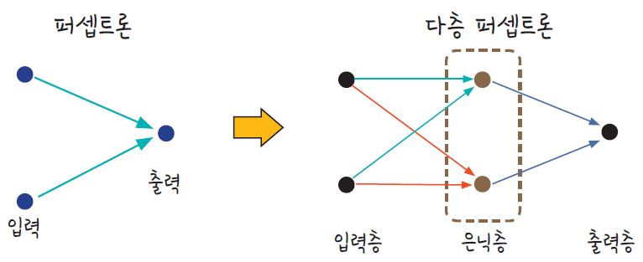
1.2. Understanding Multilayer Perceptron with Excel
UNIT 01
Solution for the XOR problem
Modify the coordinate plane itself.
To solve the XOR, you need to run two perceptrons simultaneously.
To make this possible, a hidden layer is necessary.
Perceptron to Multilayer Perceptron
Perceptron
Multilayer Perceptron
Output
Input
Input layer
Hidden layer
Output layer

Slide 32
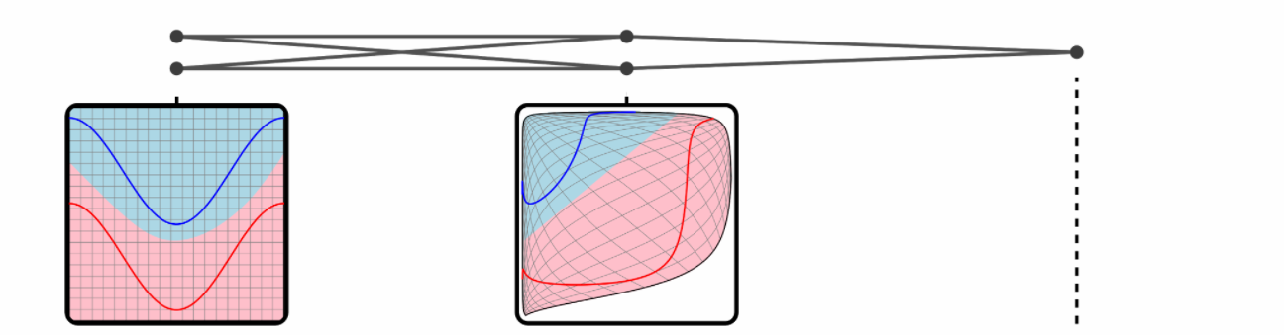
1.2. Understanding Multilayer Perceptron with Excel
UNIT 01
Solution for the XOR problem
If you divide the plane into sections of blue and red with regard to the inputs, no line can separate the two. However, if a hidden layer warps the plane, the curve line separating the two sections becomes a straight line.
Perceptron to Multilayer Perceptron
Input
(2)
hidden
(2 sigmoid)
output
(1 sigmoid)

Slide 33
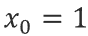
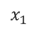
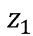
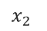
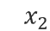
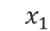
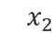
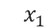
1.2. Understanding Multilayer Perceptron with Excel
UNIT 01
Solution for the XOR problem
Solving the XOR with 2 perceptrons
If perceptron ① and perceptron ② are both +1, the unit is ● . If not, ◻︎.
$$x_{2}$$
Perceptron ①
Perceptron ②
Perceptron ②
C
$$x_{0}=1$$
$$x_{0}=1$$
Perceptron ①
-0.5
1.5
A
$$x_{1}$$
1.0
$$z_{1}$$
$$x_{1}$$
-1.0
$$z_{2}$$
$$x_{1}$$
1.0
-1.0
B
- +
+ -
$$x_{2}$$
$$x_{2}$$
(a) Separating the plane by two perceptrons
(b) Two perceptrons
Solution for the XOR problem

Slide 34
1.2. Understanding Multilayer Perceptron with Excel
UNIT 01
Solution for the XOR problem
Solve the XOR problem by applying a multilayer perceptron in Excel.
Solving XOR
b1
b2
Sigmoid function
=1/(1+exp(-x))
Input layer
Hidden layer
Output layer
x1
W1
n1
W2
y_{out}
x2
n2
x1 | x2
0 | 0
0 | 1
1 | 0
1 | 1
W1
-2
2
-2
2
W2
1
1
n1 After running sigmoid function |  | x2
-1 | 0.268941 | 0
1 | 0.731059 | 1
1 | 0.731059 | 1
3 | 0.952574 | 1
n2 |  | x2
-1 | 0.268941 | 0
1 | 0.731059 | 1
1 | 0.731059 | 1
3 | 0.952574 | 1
output
0
1
1
0
Desired value
0
1
1
0
b1
3
-1
b2
-1
x1 | x2 | or | and | nand
0 | 0 | 0 | 0 | 1
0 | 1 | 1 | 0 | 1
1 | 0 | 1 | 0 | 1
1 | 1 | 1 | 1 | 0
or | nand
0 | 1 | 0
1 | 1 | 1
1 | 1 | 1
1 | 0 | 0

Slide 35
1.2. Understanding Multilayer Perceptron with Excel
UNIT 01
Solution for the XOR problem
Compute the XOR by applying a multilayer perceptron in Excel.
Solving XOR
b1
b2
Input layer
Hidden layer
Output layer
x
W1
n
W2
y_{out}
x
n
x1 | x2
0 | 0
0 | 1
1 | 0
1 | 1
W1
-2
2
-2
2
W2
1
1
n1 After running sigmoid function | After running sigmoid function | x2
=C12*$F$12+D12*$F$14+$F$18 | =1/(1+EXP(-K12)) | 1
=C13*$F$12+D13*$F$14+$F$18 | =1/(1+EXP(-K13)) | 1
=C14*$F$12+D14*$F$14+$F$18 | =1/(1+EXP(-K14)) | 1
=C15*$F$12+D15*$F$14+$F$18 | =1/(1+EXP(-K15)) | 0
n2 | After running sigmoid function | x2
=C12*$F$13+D12*$F$15+$F$19 | =1/(1+EXP(-O12)) | 0
=C13*$F$13+D13*$F$15+$F$19 | =1/(1+EXP(-O13)) | 1
=C14*$F$13+D14*$F$15+$F$19 | =1/(1+EXP(-O14)) | 1
=C15*$F$13+D14*$F$15+$F$19 | =1/(1+EXP(-O15)) | 1
b1
3
-1
b2
-1
x1 | x2 | or | and | nand
0 | 0 | 0 | 0 | 1
0 | 1 | 1 | 0 | 1
1 | 0 | 1 | 0 | 1
1 | 1 | 1 | 1 | 0
or | nand
0 | 1 | 0
1 | 1 | 1
1 | 1 | 1
1 | 0 | 0

Slide 36
1.2. Understanding Multilayer Perceptron with Excel
UNIT 01
Solution for the XOR problem
Compute the XOR by applying a multilayer perceptron in Excel.
Solving XOR
b1
b2
Input layer
Hidden layer
Output layer
x
W1
n
W2
y_{out}
x
n
x1 | x2
0 | 0
0 | 1
1 | 0
1 | 1
W1
-2
2
-2
2
W2
1
1
n1 After running sigmoid function | After running sigmoid function | x2
=C12*$F$12+D12*$F$14+$F$18 | =1/(1+EXP(-K12)) | 1
=C13*$F$12+D13*$F$14+$F$18 | =1/(1+EXP(-K13)) | 1
=C14*$F$12+D14*$F$14+$F$18 | =1/(1+EXP(-K14)) | 1
=C15*$F$12+D15*$F$14+$F$18 | =1/(1+EXP(-K15)) | 0
n2 | After running sigmoid function | x2
=C12*$F$13+D12*$F$15+$F$19 | =1/(1+EXP(-O12)) | 0
=C13*$F$13+D13*$F$15+$F$19 | =1/(1+EXP(-O13)) | 1
=C14*$F$13+D14*$F$15+$F$19 | =1/(1+EXP(-O14)) | 1
=C15*$F$13+D14*$F$15+$F$19 | =1/(1+EXP(-O15)) | 1
b1
3
-1
b2
-1
x1 | x2 | or | and | nand
0 | 0 | 0 | 0 | 1
0 | 1 | 1 | 0 | 1
1 | 0 | 1 | 0 | 1
1 | 1 | 1 | 1 | 0
or | nand
0 | 1 | 0
1 | 1 | 1
1 | 1 | 1
1 | 0 | 0

Slide 37
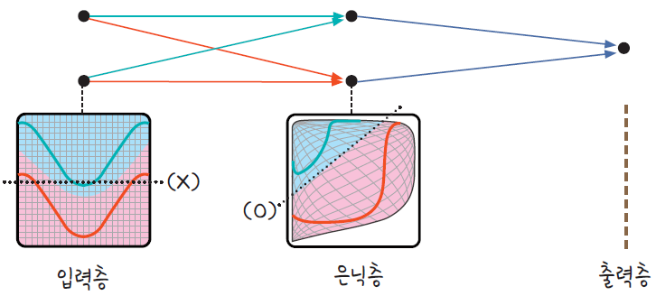
1.2. Understanding Multilayer Perceptron with Excel
UNIT 01
Solution for the XOR problem
The hidden layer warps the coordinate plane.
Hidden layer warps the plane. (https://goo.gl/8qEGHD for more reference)
x1 | x2 | or | and | nand | or | nand | xor
0 | 0 | 0 | 0 | 1 | 0 | 1 | 0
0 | 1 | 1 | 0 | 1 | 1 | 1 | 1
1 | 0 | 1 | 0 | 1 | 1 | 1 | 1
1 | 1 | 1 | 1 | 0 | 1 | 0 | 0
Input layer
Hidden layer
Output layer

Slide 38
1.2. Understanding Multilayer Perceptron with Excel
UNIT 01
『Perceptrons』 by Minsky
Minsky pointed out the limitations of the perceptron and suggested a multilayer structure as a solution. The level of technology at the time was not advanced enough to materialize his idea.
In 1974, Paul Werbos proposed a backpropagation algorithm in his doctoral thesis.
In 1986, Rumelhart established the multilayer theory in his book 『Parallel Distributed Processing』 and revived interest in the neural network.

Slide 39
1.2. Understanding Multilayer Perceptron with Excel
UNIT 01
Central Idea to the Multilayer Perceptron
Insert a hidden layer. It transforms a given feature space into a new one that is more favorable for classification.
Use a sigmoid activation function. Perceptron used a step function as an activation function. This function is categorized as a hard decision decoder. However, a multilayer perceptron utilizes a sigmoid function, which is a soft decision decoder, as an activation function. In soft-decision decoding, the output is continuous and indicates confidence. This enables more flexible decision-making.
Use a backpropagation algorithm. A multilayer perceptron consists of many layers in consecutive order. Thus, a backpropagation algorithm is effective that progresses in reverse order, computes gradients, and renews weights in each layer.

Slide 40
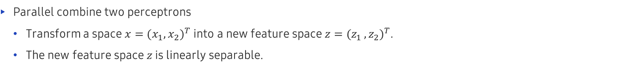





1.2. Understanding Multilayer Perceptron with Excel
UNIT 01
Central Idea to the Multilayer Perceptron
Parallel combine two perceptrons
Transform a space $x={(x_{1}, x_{2})}^{T}$ into a new feature space $z={(z_{1 }, z_{2})}^{T}$.
The new feature space $z$ is linearly separable.
$$x_{2}$$
$$z_{2}$$
②
$$x_{0}=1$$
-0.5
1.0
$$z_{1}$$
1.0
①
$$z$$
$$x_{1}$$
1.5
Ⓑ
Ⓐ
-1.0
$$z_{2}$$
Ⓒ
$$x_{2}$$
-1.0
$$x_{1}$$
- +
+ -
(a) Parallel combine two perceptrons
(b) Transform a feature space x into a new feature space z
Transformation of a feature space
Equivalent to a human-being manually executing feature learning

Slide 41


1.2. Understanding Multilayer Perceptron with Excel
UNIT 01
Central Idea to the Multilayer Perceptron
If you serial combine a single perceptron
In feature space $z$, if you serial combine perceptron 3, which performs linear classification, it becomes a multilayer perceptron.
Perceptron ③
$$z_{2}$$
Perceptron ③
$$x_{0}=1$$
$$1$$
-0.5
-1.0
$$z_{1}$$
$$x_{1}$$
1.0
1.0
1.0
-1.0
1.5
1.0
$$x_{2}$$
-1.0
(a) Separation in a new feature space
(b) Multilayer perceptron that combines three perceptrons
Multilayer Perceptron

Slide 42
1.2. Understanding Multilayer Perceptron with Excel
UNIT 01
Central Idea to the Multilayer Perceptron
A threshold function is a hard-decision decoder (transforms an area into a dot). Other activation functions are soft-decision decoders (transform an area into an area).
1
1
0.5
0.5
0
0
-0.5
-0.5
-1
-1
-6
-4
-2
0
2
4
6
-6
-4
-2
0
2
4
6
(a) Threshold function
(b) Logistic sigmoid
Activation function used in neural network

Slide 43
Unit 1.
Basics of Neural Network
1.1. Understanding Perceptron with Excel
1.2. Understanding Multilayer Perceptron with Excel
1.3. From Multilayer Perceptron to Deep Learning
1.4. Error Backpropagation and Gradient Descent to Reduce Errors
1.5. Activation Function
1.6. Deep Learning
1.7. Problems with Deep Learning and the Solutions

Slide 44


1.3. From Multilayer Perceptron to Deep Learning
UNIT 01
Artificial Neural Network (ANN)
About the artificial neural network (ANN)
Input Layer
Hidden Layers
Output Layer
$$X$$
$$Y$$
Mimics the neural connections of a biological brain.
There can be several hidden layers.
Notes:
An artificial neural network (ANN) mimics the biological brain.
A node with all the connecting edges would correspond to a neuron.
In an ANN, the nodes are organized in layers.
There can be more than one inner layer that remain hidden.
Thus, these inner layers are often called “hidden layers."

Slide 45
1.3. From Multilayer Perceptron to Deep Learning
UNIT 01
Why Artificial Neural Network (ANN)?
For a logistic regression (even for the multi-class variant), the decision boundaries are linear.
How about the cases that require non-linear decision boundaries? ⇒ ANN with hidden layers!
Notes:
But, why do we want to use an ANN instead of simpler algorithms such as logistic regression?
One of the answers is that with an ANN we can recognize more complex patterns.
With an ANN, we can draw decision boundaries that are non-linear.

Slide 46









1.3. From Multilayer Perceptron to Deep Learning
UNIT 01
ANN training: forward propagation
1) When the values of $X_{i}$ are given, apply the weights and propagate the signal forward to the next layer.
Example
$b_{1},b_{2}$, $b_{3}$
$$x_{1}$$
$$w_{11}$$
$$w_{21}$$
$$x_{1}^{1}$$
$$w_{31}$$
$$x_{2}$$
$$w_{12}$$
$$w_{22}$$
$$w_{32}$$
$$x_{2}^{1}$$
$$x_{3}$$
$$w_{13}$$
$$w_{23}$$
$$w_{33}$$
$$w_{24}$$
$$x_{3}^{1}$$
$$w_{14}$$
$$x_{4}$$
$$w_{34}$$
$$\left[\begin{matrix}x_{1}^{1} \\ x_{2}^{1} \\ x_{3}^{1}\end{matrix}\right]=Activation\left(\left[\begin{matrix}\begin{matrix}\begin{matrix}w_{11} & w_{12}\end{matrix} & \begin{matrix}w_{13} & w_{14}\end{matrix} \\ \begin{matrix}w_{21} & w_{22}\end{matrix} & \begin{matrix}w_{23} & w_{24}\end{matrix}\end{matrix} \\ \begin{matrix}\begin{matrix}w_{31} & w_{32}\end{matrix} & \begin{matrix}w_{33} & w_{34}\end{matrix}\end{matrix}\end{matrix}\right]∙\left[\begin{matrix}\begin{matrix}x_{1} \\ x_{2}\end{matrix} \\ \begin{matrix}x_{3} \\ x_{4}\end{matrix}\end{matrix}\right]+\left[\begin{matrix}b_{1} \\ b_{2} \\ b_{3}\end{matrix}\right]\right)$$
Notes:
Instead of going fully mathematical, let us illustrate the steps involved in training an ANN.
Of course, we will apply the gradient descent algorithm (plain vanilla or a variant of it).
As we can recall, the ultimate goal of the gradient descent algorithm is to optimize the model parameters (weights) such that the mismatch or error becomes as small as possible.
The first step involves propagating forward the input signals (values of the explanatory variables) to the next layer (first hidden layer).
This requires a matrix multiplication between a weight matrix and the signals as shown here.
Here, $w_{ji}$ is the weight of the edge that connects the node-i in the input layer with the node-j in the first hidden layer.
$Activation()$represents the activation function. Then, $x_{i}^{1}$ would be the value coming out from the node-i of the first hidden layer.
The nodes of the first hidden layer can be regarded as source of new signals that can be propagated to the second hidden layer.
So on and so forth, we do forward propagation layer by layer doing matrix multiplications and applying the activation function.

Slide 47


1.3. From Multilayer Perceptron to Deep Learning
UNIT 01
ANN training: forward propagation
2) Propagate forward to the next layer.
Example
$$b_{1},b_{2}\text{,}b_{3}\text{,}b_{4}$$
$$w_{11}$$
$$x_{1}^{2}$$
$$x_{1}^{1}$$
$$w_{12}$$
$$w_{13}$$
$$w_{21}$$
$$x_{2}^{2}$$
$$w_{22}$$
$$x_{2}^{1}$$
$$w_{23}$$
$$w_{31}$$
$$w_{32}$$
$$x_{3}^{2}$$
$$w_{33}$$
$$x_{3}^{1}$$
$$w_{41}$$
$$w_{42}$$
$$w_{43}$$
$$x_{4}^{2}$$
$$\left[\begin{matrix}\begin{matrix}x_{1}^{2} \\ x_{2}^{2}\end{matrix} \\ \begin{matrix}x_{3}^{2} \\ x_{4}^{2}\end{matrix}\end{matrix}\right] =Activation\left(\left[\begin{matrix}\begin{matrix}w_{11} & w_{12} & w_{13} \\ w_{21} & w_{22} & w_{23}\end{matrix} \\ \begin{matrix}w_{31} & w_{32} & w_{33} \\ w_{42} & w_{42} & w_{43}\end{matrix}\end{matrix}\right]∙\left[\begin{matrix}x_{1}^{1} \\ x_{2}^{1} \\ x_{3}^{1}\end{matrix}\right]+\left[\begin{matrix}\begin{matrix}b_{1} \\ b_{2}\end{matrix} \\ \begin{matrix}b_{3} \\ b_{4}\end{matrix}\end{matrix}\right]\right)$$
Notes:
On the first hidden layer, we proceed similarly as before to propagate the signals forward to the second hidden layer.
Again, this involves a matrix multiplication and passing through the activation function.

Slide 48
Unit 1.
Basics of Neural Network
1.1. Understanding Perceptron with Excel
1.2. Understanding Multilayer Perceptron with Excel
1.3. From Multilayer Perceptron to Deep Learning
1.4. Error Backpropagation and Gradient Descent to Reduce Errors
1.5. Activation Function
1.6. Deep Learning
1.7. Problems with Deep Learning and the Solutions

Slide 49












1.4. Error Backpropagation and Gradient Descent to Reduce Errors
UNIT 01
ANN training: forward propagation
Propagate all the way; the difference between the estimated value $\hat{y}$ and the true value 𝑦 is the error.
Example
$$b$$
$$x_{1}^{2}$$
$$w_{1}$$
$$w_{2}$$
$$x_{2}^{2}$$
$$\hat{y}$$
$≅y$?
$$w_{3}$$
$$x_{3}^{2}$$
Error $=y−\hat{y}$
$$w_{4}$$
$$x_{4}^{2}$$
$$\hat{y}=Activation\left(\left[\begin{matrix}\begin{matrix}w_{1} & w_{2}\end{matrix} & \begin{matrix}w_{3} & w_{4}\end{matrix}\end{matrix}\right]∙\left[\begin{matrix}\begin{matrix}x_{1}^{2} \\ x_{2}^{2}\end{matrix} \\ \begin{matrix}x_{3}^{2} \\ x_{4}^{2}\end{matrix}\end{matrix}\right]+\text{b}\right)$$
Notes:
Eventually, the output layer is reached and we get the estimated value of the response $\hat{y}$.
Comparing this with the true value, we can calculate the mismatch or error (loss).

Slide 50


1.4. Error Backpropagation and Gradient Descent to Reduce Errors
UNIT 01
ANN training: backward propagation
Propagate the error backward and update the parameters by gradient descent algorithm. Repeat from 1).
Example
$$W← W− η ∇L\text{oss}$$
$$b ← b− η ∇L\text{oss}$$
$$Error or Loss$$
Notes:
The next step consists in the backward propagation of the error.
By this, it is meant a layer by layer update of the parameters (from the right to left) using the gradient descent algorithm.
In the end, we have a set of parameters ($b$ and $W$) one step closer to the optimal.
We repeat from the step 1) for a given number of times until the optimal set of parameters is obtained.

Slide 51
Unit 1.
Basics of Neural Network
1.1. Understanding Perceptron with Excel
1.2. Understanding Multilayer Perceptron with Excel
1.3. From Multilayer Perceptron to Deep Learning
1.4. Error Backpropagation and Gradient Descent to Reduce Errors
1.5. Activation Function
1.6. Deep Learning
1.7. Problems with Deep Learning and the Solutions

Slide 52


1.5. Activation Function
UNIT 01
Activation Function
Activation function: Linear threshold or Step
$Step\left(x\right)=θ(x−x_{0})$
An activation function that was frequently used in the early days of neural networks is the step function.
Step
1
0
$$x_{0}$$
$$x$$
Notes:
An activation function that was frequently used in the early days of neural network is the step function.

Slide 53



1.5. Activation Function
UNIT 01
Activation function: Sigmoid $σ\left(x\right)$
$σ\left(x\right)=\frac{1}{{1+e}^{−x}}$
When we have more than two classes, it can be generalized to the “Softmax."
The Sigmoid is another widely used activation function. Note that the output value ranges between 0 and 1.
Sigmoid
+1
0
$$x$$
Notes:
The Sigmoid is another widely used activation function.
Please, notice that the output value ranges between 0 and 1.

Slide 54

1.5. Activation Function
UNIT 01
Activation function: Hyperbolic tangent or tanh
$tanh\left(x\right)=\frac{e^{x}−e^{−x}}{e^{x}+e^{−x}}$
The hyperbolic tangent (tanh) looks similar to the Sigmoid. However, the output value ranges between -1 and +1.
tanh
+1
0
-1
Notes:
The hyperbolic tangent (tanh) looks similar to the Sigmoid.
However, notice that the output value ranges between -1 and +1.

Slide 55

1.5. Activation Function
UNIT 01
Activation function: Linear
$Linear(x)=x$
The linear activation’s output is the same as the input. The linear activation function is used in the regression.
Linear
0
$$x$$
Notes:
The linear activation’s output is the same as the input.
We used the linear activation function in the regression.

Slide 56

1.5. Activation Function
UNIT 01
Activation function: ReLu (Rectifier Linear Unit)
$ReLu\left(x\right)=max\left(0,x\right)$
ReLu is another commonly used activation function. It can be expressed in a simple functional form.
ReLu
0
$$x$$
Notes:
ReLu is another commonly used activation function.
It can be expressed in a simple functional form.

Slide 57

1.5. Activation Function
UNIT 01
Activation function: Leaky ReLu
$Leaky ReLu\left(x\right)=max\left(αx,x\right) \text{where} α∈\left(0,1\right)$
Leaky ReLu is a slightly “tweaked” version of ReLu.
Leawky ReLu
0
$$x$$
Notes:
Leaky ReLu is a slightly “tweaked” version of ReLu.

Slide 58

1.5. Activation Function
UNIT 01
Activation function (summary)
This summarizes some of the most commonly used activation functions.
Softmax is often used at the output layer of neural networks that do classification.
Name | Formula | TensorFlow
Step | $$Step\left(x\right)=θ\left(x−x_{0}\right)$$ | $$\frac{tf.math.sign\left(x−x_{0}\right)+1}{2}$$
Sigmoid | $$σ\left(x\right)=\frac{1}{1+e^{−x}}$$ | tf.math.sigmoid(x)
Tanh | $$\tanh\left(x\right)=\frac{e^{x}−e^{−x}}{e^{x}+e^{−x}}$$ | tf.math.tanh(x)
ReLu | $$ReLu\left(x\right)=max⁡(0,x)$$ | tf.nn.relu(x)
Softmax | $${σ(x)}_{j}=\frac{e^{x_{j}}}{\sum_{k=1}^{K}{e^{x_{k}}}}$$ | tf.nn.softmax(x)
Notes:
This is a summary of some of the most commonly used activation functions.
Softmax is often used at the output layer of neural networks that do classification.

Slide 59
Unit 1.
Basics of Neural Network
1.1. Understanding Perceptron with Excel
1.2. Understanding Multilayer Perceptron with Excel
1.3. From Multilayer Perceptron to Deep Learning
1.4. Error Backpropagation and Gradient Descent to Reduce Errors
1.5. Activation Function
1.6. Deep Learning
1.7. Problems with Deep Learning and the Solutions

Slide 60

1.6. Deep Learning
UNIT 01
Artificial neural networks: a recommended site
Access the website below to check artificial neural networks.
Website: https://playground.tensorflow.org
Notes:
Please, visit this website and have a look.

Slide 61
1.6. Deep Learning
UNIT 01
Artificial neural networks: a recommended site
The GUI of the website (https://playground.tensorflow.org) is intuitive.
Select data from the left side panel of the website.
Adjust the features, layers, and nodes.
From the top dropdown menus, customize the learning rate, activation function, regularization, etc.
Press the Play button to start training ⇒ training loss decreases as the training progresses.
The thickness of an edge line represents the weight that can also be changed manually.

Slide 62





1.6. Deep Learning
UNIT 01
About the Deep Neural Network (DNN)
There may be several hidden layers.
With more hidden layers, we have a higher degree of abstraction.
Input Layer
Hidden Layers
Output Layer
$$⋯$$
$$X$$
$$⋯$$
$$Y$$
$$⋯$$
Notes:
A DNN may have several hidden layers.
This may introduce some additional difficulties as we will see.

Slide 63
Unit 1.
Basics of Neural Network
1.1. Understanding Perceptron with Excel
1.2. Understanding Multilayer Perceptron with Excel
1.3. From Multilayer Perceptron to Deep Learning
1.4. Error Backpropagation and Gradient Descent to Reduce Errors
1.5. Activation Function
1.6. Deep Learning
1.7. Problems with Deep Learning and the Solutions

Slide 64



1.7. Problems of Deep Learning and the Solution
UNIT 01
Common problems with the DNN
As the ‘signal’ propagates through the layers, it can die out (vanish) or grow uncontrollably.
a) We should avoid using the Sigmoid 𝜎(𝑥) as the activation function but use the ReLu instead.
→ The derivative 𝜎′(𝑥) becomes very small as the absolute value of 𝑥 or |𝑥| increases.
→ Small 𝜎′(𝑥) may cause the so-called vanishing gradient problem.
$$σ\left(x\right)$$
$$σ′\left(x\right)$$
+1
0
$$x$$
Notes:
One of the common problems afflicting a DNN is that the signal may die out or grow exponentially.
One of the measures we can take is to avoid using the Sigmoid activation function at the hidden layers.

Slide 65

1.7. Problems of Deep Learning and the Solution
UNIT 01
Common problems with the DNN
As the ‘signal’ propagates through the layers, it can die out (vanish) or grow uncontrollably.
b) We should initialize the weights such that the variance of the internal nodes is roughly constant.
→ Initializing as a constant such as 1 is not optimal.
→ Better to randomly initialize the weights with center at 0 and standard deviation ~$\frac{1}{\sqrt{N_{nodes}}}$.(*)
Here, $N_{nodes}$ = average number of nodes in the neighboring layers (before and after).
(*) Refer to the research paper at http://proceedings.mlr.press/v9/glorot10a/glorot10a.pdf.
Notes:
Another measure to “stabilize” the signal is to use a clever initialization method.
(*) Xavier-Glorot initialization. Please, refer to the research paper at http://proceedings.mlr.press/v9/glorot10a/glorot10a.pdf.

Slide 66
1.7. Problems of Deep Learning and the Solution
UNIT 01
Common problems with the DNN
Also, DNNs are prone to overfitting. To alleviate this problem, we can do the following:
a) Regularization of the weights: L1 or L2 regularization similar to the Lasso or Ridge
b) Dropout: randomly exclude certain nodes during the training step to avoid over-dependency
c) Data augmentation: add noise, create new data by transformation, etc.
Notes:
Also, DNNs are prone to the overfitting.
This is so because as the number of hidden layers increases, there will be a large number of parameters (weights).
The neural network becomes overly complex and the usual overfitting situation is encountered.
It is quite easy to overfit with a DNN.
There are some counter measures as listed here.

Slide 67
1.7. Problems of Deep Learning and the Solution
UNIT 01
Dropout
Randomly exclude certain nodes during the training step to avoid over dependency.
Notes:
One of the most effective measures to counter the overfitting is the dropout.
Dropout consists in randomly excluding certain nodes during the training phase.

Slide 68
1.7. Problems of Deep Learning and the Solution
UNIT 01
Dropout
Randomly exclude certain nodes during the training step to avoid over dependency.
Notes:
One of the most effective measures to counter the overfitting is the dropout.
Dropout consists in randomly excluding certain nodes during the training phase.

Slide 69
1.7. Problems of Deep Learning and the Solution
UNIT 01
Dropout
When predicting, use all the nodes and edges without excluding.
Notes:
While dropout is applied during the training phase, when predicting all the nodes should be used.

Slide 70
Unit 2.
Basics of TensorFlow
2.1. Introduction to TensorFlow
2.2. TensorFlow dataset
2.3. Machine Learning with TensorFlow

Slide 71

2.1. Introduction to TensorFlow
UNIT 02
Introduction to TensorFlow
About TensorFlow
TensorFlow can utilize both CPU and GPU to improve the training performance of a machine learning model.
It can produce maximum performance only with GPU.
TensorFlow officially supports CUDA-capable GPU.
TensorFlow Lite supports OpenCL GPU.
Tensoflow is a front-end interface that supports various programming languages.
Notes:
An open source machine learning/deep learning library developed by the Google Brain team.
Computations are expressed as graphs.
Supports Windows, mac OS, Linux, etc.
Supports Python, Java, R, etc.
Runs on multiple CPUs and GPUs.
For more information refer to the official site: https://www.tensorflow.org/

Slide 72
2.1. Introduction to TensorFlow
UNIT 02
About TensorFlow
Since TensorFlow’s Python API is fully mature, it is popular to deep learning and machine learning technologists.
TensorFlow has its official C ++ API as well.
In addition, two new TensorFlow-based libraries, TensorFlow.js and TensorFlow Lite, were introduced.
APIs for Java, Haskell, Node.js, or Go are also supported.
TensorFlow developers and open source community are constantly working to resolve such issues.

Slide 73
2.1. Introduction to TensorFlow
UNIT 02
What is TensorFlow?
TensorFlow generates a computational graph composed of a series of nodes.
Each node expresses an operation that can denote more than 0 input or output.
Tensor was created as a symbolic handle to refer to inputs and outputs of such operation.
Notes:
Please, for more information refer to the official site:
https://www.tensorflow.org/
Google developed TensorFlow and introduced it to the public as an open source in Nov 2015.
Countless projects use TensorFlow for image classification, natural language processing, recommender system, time-series forecasting and all the other machine learning tasks.

Slide 74
2.1. Introduction to TensorFlow
UNIT 02
Why TensorFlow?
TensorFlow immensely expedites the machine learning process.
Performance issue
Since the performance of computer processors has consistently improved in the past years, it can train more complex and powerful machine learning systems.
It can enhance the machine learning model’s prediction accuracy.
Even the cheapest computer hardware carries processors with a number of cores.
Numerous functions from Scikit-learn can disperse an operation into a number of processes.
Generally, Python can only run one core due to GIL (Global Interpreter Lock).
Multiproceessing libraries can disperse an operation into multiple cores. Still, even the most advanced desktop PCs do not carry more than 64 or 128 cores.

Slide 75
2.1. Introduction to TensorFlow
UNIT 02
Why TensorFlow?
Even the simplest multilayer perceptron has a hundred units in a single hidden layer.
You need about 80,000 weight parameters ([784×100 + 100] + [100×10 + 10] = 79,510) to train a model to classify even the simplest images.
MNIST is a relatively small image (28×28 pixels).
The number of weight parameters will radically increase when processing high-pixel images or adding hidden layers.
Such tasks are difficult to operate on a single process.
How can you effectively resolve such an issue?

Slide 76
2.1. Introduction to TensorFlow
UNIT 02
Why TensorFlow?
A foolproof solution to this issue is a GPU of exceptional performance level.
A graphic card could be considered a small computer cluster within a computer.
You can buy a GPU that carries 290 times more core and executes 10 times more floating point operations per second, with 70% price of the latest CPU.
Writing code for a certain CPU is not as easy as running code on a Python interpreter.
There are packages such as CUDA or OpenCL that enable the usage of designated GPUs.
However, CUDA or OpenCL does not offer the best environment to write code for machine learning algorithms.
TensorFlow was developed from such a background.

Slide 77
2.1. Introduction to TensorFlow
UNIT 02
What is TensorFlow?
Refer to the figure below to precisely understand the notion of a tensor.
The first row shows rank 0 and 1 tensors. The second row shows rank 2 and 3 tensors.
Ex
Tensors
Rank 0:
Rank 1:
(scalar)
(vector)
Rank 2: (matrix)
Rank 3:

Slide 78
2.1. Introduction to TensorFlow
UNIT 02
What is TensorFlow?
TensorFlow creates a computational graph composed of a series of nodes.
Each node expresses an operation that can denote more than 0 input or output.
Tensor was created as a symbolic handle to refer to inputs and outputs of such operation.
A tensor can be understood in mathematical forms of scalar, vector, matrix, etc.
To be more precise, a scalar can be defined as a rank 0 tensor, a vector as a rank 1 tensor, a matrix as a rank 2 tensor, and a matrix with three dimensions as a rank 3 tensor.
The actual values are stored as NumPy arrays, and the tensor provides a reference for this array.

Slide 79
2.1. Introduction to TensorFlow
UNIT 02
What is TensorFlow?
Let’s discuss the programming mechanisms of TensorFlow.
Learn how to create and modify tensors.
Learn how to load data and use TensorFlow Dataset objects which efficiently circulate datasets.
Study the datasets in the TensorFlow datasets module.
Let’s get acquainted with tf.keras API and build a machine learning model.
Learn how to compile and train this model and store the trained model in a drive.

Slide 80
2.1. Introduction to TensorFlow
UNIT 02
What is TensorFlow?
In TensorFlow version 1.x, it supported a static computational graph that expressed the flow of data.
Many users had a difficult time utilizing the static computational graph. This issue has been resolved in the recent 2.0 version, and the user can create and train neural network models more easily.
TensorFlow 2.0 still supports static computational graphs, but dynamic computational graphs are the default.

Slide 81
2.1. Introduction to TensorFlow
UNIT 02
Installing TensorFlow
Use Python’s pip installer to install TensorFlow from PyPI.
Run the following command on the terminal.
> pip install tensorflow
This command installs the most recent, stable version.
Version 2.12.0 at the time of writing.
Recommend using TensorFlow 2.12.0 for codes (in this chapter) to show expected results.
The command below installs a designated version.
> pip install tensorflow==[desired-version]

Slide 82

2.1. Introduction to TensorFlow
UNIT 02
Checking TensorFlow version
Run the code below to check the version.
‘2.12.0’

Slide 83
2.1. Introduction to TensorFlow
UNIT 02
Installing TensorFlow
For GPU, you need an NVIDIA-compatible graphic card and an installation of CUDA Toolkit and cuDNN library (GPU is recommended for neural network training).
If the above conditions are fulfilled, you can install the TensorFlow GPU version.
> pip install tensorflow-gpu
Refer to the official website for more information on installation (https://www.tensorflow.org/install/gpu).

Slide 84
2.1. Introduction to TensorFlow
UNIT 02
TensorFlow learning procedure
New version is released every few months due to TensorFlow’s fast developing rate.
Let’s study several ways to create a tensor.
Then, study the features of TensorFlow and methods for modification.
First, use tf.convert to tensor to create a tensor in a list or NumPy array.

Slide 85

2.1. Introduction to TensorFlow
UNIT 02
TensorFlow learning procedure
New version is released every few months due to TensorFlow’s fast developing rate.
Let’s study several ways to create a tensor.
Then, study the features of TensorFlow and methods for modification.
First, use tf.convert to tensor to create a tensor in a list or NumPy array.

Slide 86

2.1. Introduction to TensorFlow
UNIT 02
Creating a tensor in TensorFlow
The tf.convert to tensor function supports tf.Variable objects unlike the tf.constant function (which will be discussed soon).
The tf.fill function and the tf.one hot function also create a tensor.

Slide 87
2.1. Introduction to TensorFlow
UNIT 02
Creating a tensor in TensorFlow
The tf.fill function generates a tensor composed of scalar inputs.
The first parameter delivers the tensor’s shape like the tf.ones function.
The second parameter delivers the desired scalar input. The code below returns the following result identical to that of tf.ones ((2,3)).
The tf.fill function is more efficient than the tf.ones to generate tensors of larger size.

Slide 88

2.1. Introduction to TensorFlow
UNIT 02
Creating a tensor in TensorFlow
tf.one_hot is a useful function to generate a one-hot encoding matrix.
First parameter: an index that displays the location for one-hot encoding
Second parameter: the length of the one-hot encoding vector
The size of the generated matrix is (length of the first parameter x second parameter).
Ex
The code below generates a one-hot encoding matrix of (3 x 4) size.

Slide 89

2.1. Introduction to TensorFlow
UNIT 02
Modifying shape and data type of a tensor

Slide 90

2.1. Introduction to TensorFlow
UNIT 02
Modifying shape and data type of a tensor

Slide 91

2.1. Introduction to TensorFlow
UNIT 02
Applying the math operation on a tensor

Slide 92

2.1. Introduction to TensorFlow
UNIT 02
Applying the math operation on a tensor

Slide 93

2.1. Introduction to TensorFlow
UNIT 02
Applying the math operation on a tensor

Slide 94

2.1. Introduction to TensorFlow
UNIT 02
Applying the math operation on a tensor
NumPy function loads __array__() method of the pertaining object before processing the input parameter. This part of the process makes the object compatible with NumPy.
For example, you can use the Series object from pandas in NumPy API. Since this method is also embodied in the tensor, you can put a tensor as an input in a NumPy function.
Many mathematical functions are referrable at the most advanced level. For example, they can be referred to as tf.multiply(), tf.reduce_mean(), tf.reduce_sum(), and tf.matmul(). For Python 3.5 version or above, it can perform matrix operations using @ operator. For example, The computation below returns results identical to that of the previous slide.

Slide 95

2.1. Introduction to TensorFlow
UNIT 02
split(), stack(), concatenate() functions

Slide 96

2.1. Introduction to TensorFlow
UNIT 02
split(), stack(), concatenate() functions

Slide 97

2.1. Introduction to TensorFlow
UNIT 02
Coding Exercise #0601
Follow practice steps on ‘ex_0601.ipynb' file
Notes:
Note:
WHAT THIS PRACTICE ABOUT
In this practice, you learn how to create NumPy arrays and work with their attributes.
PRACTICE INSTRUCTION
Click Window button.
Search the “anaconda prompt” and Run.
Type the command "jupyter notebook" and press Enter.
In Jupyter Notebook, go to the folder containing the practice files. (If you don’t have practice files yet, ask your instructor)
Click Coding Exercise folder.
Click the ex_0601.ipynb file.
Review the examples on the topics below:
NumPy library.
NumPy basics.
Creating NumPy arrays.
Indexing and slicing NumPy arrays.
NumPy attributes and reshaping.
Modifying NumPy arrays.
(Optional) Use the blank cell at the bottom to practice your own personal needs.

Slide 98
Unit 2.
Basics of TensorFlow
2.1. Introduction to TensorFlow
2.2. TensorFlow dataset
2.3. Machine Learning with TensorFlow

Slide 99

2.2. TensorFlow dataset
UNIT 02
Building TensorFlow dataset in a tensor

Slide 100

2.2. TensorFlow dataset
UNIT 02
Connecting two tensors in one dataset (1/2)
Approach 1

Slide 101

2.2. TensorFlow dataset
UNIT 02
Connecting two tensors in one dataset (2/2)
Approach 2

Slide 102

2.2. TensorFlow dataset
UNIT 02
shuffle(), batch(), repeat() methods (1/7)
batch
batch
batch
batch

Slide 103

2.2. TensorFlow dataset
UNIT 02
shuffle(), batch(), repeat() methods (2/7)

Slide 104

2.2. TensorFlow dataset
UNIT 02
shuffle(), batch(), repeat() methods (3/7)
## Step 1

Slide 105

2.2. TensorFlow dataset
UNIT 02
shuffle(), batch(), repeat() methods (4/7)
## Step 1

Slide 106

2.2. TensorFlow dataset
UNIT 02
shuffle(), batch(), repeat() methods (5/7)
## Step 2

Slide 107

2.2. TensorFlow dataset
UNIT 02
shuffle(), batch(), repeat() methods (6/7)
## Step 2

Slide 108

2.2. TensorFlow dataset
UNIT 02
shuffle(), batch(), repeat() methods (7/7)
## Step 3

Slide 109

2.2. TensorFlow dataset
UNIT 02
Building dataset from a file stored in a local drive (1/6)

Slide 110

2.2. TensorFlow dataset
UNIT 02
Building dataset from a file stored in a local drive (2/6)
'Image Size:

Slide 111


2.2. TensorFlow dataset
UNIT 02
Building dataset from a file stored in a local drive (3/6)

Slide 112

2.2. TensorFlow dataset
UNIT 02
Building dataset from a file stored in a local drive (4/6)
46
47

Slide 113

2.2. TensorFlow dataset
UNIT 02
Building dataset from a file stored in a local drive (5/6)
48

Slide 114


2.2. TensorFlow dataset
UNIT 02
Building dataset from a file stored in a local drive (6/6)

Slide 115

2.2. TensorFlow dataset
UNIT 02
Loading datasets from tensorflow.datasets library (1/10)
49

Slide 116
2.2. TensorFlow dataset
UNIT 02
Loading datasets from tensorflow.datasets library (2/10)
50

Slide 117

2.2. TensorFlow dataset
UNIT 02
Loading datasets from tensorflow.datasets library (3/10)
The following command generates the entire list.
51
51

Slide 118

2.2. TensorFlow dataset
UNIT 02
Loading datasets from tensorflow.datasets library (4/10)
Downloading cifar100 dataset
52

Slide 119

2.2. TensorFlow dataset
UNIT 02
Loading datasets from tensorflow.datasets library (5/10)
Downloading and saving data in a local drive
53

Slide 120

2.2. TensorFlow dataset
UNIT 02
Loading datasets from tensorflow.datasets library (6/10)
Loading data from the drive by tf.data.Datasets
54
50

Slide 121

2.2. TensorFlow dataset
UNIT 02
Loading datasets from tensorflow.datasets library (7/10)
55

Slide 122

2.2. TensorFlow dataset
UNIT 02
Loading datasets from tensorflow.datasets library (8/10)
56
57

Slide 123

2.2. TensorFlow dataset
UNIT 02
Loading datasets from tensorflow.datasets library (9/10)
58

Slide 124


2.2. TensorFlow dataset
UNIT 02
Loading datasets from tensorflow.datasets library (10/10)

Slide 125

2.2. TensorFlow dataset
UNIT 02
Another approach to loading datasets (1/3)

Slide 126

2.2. TensorFlow dataset
UNIT 02
Another approach to loading datasets (2/3)
60

Slide 127

2.2. TensorFlow dataset
UNIT 02
Another approach to loading datasets (3/3)

Slide 128
Unit 2.
Basics of TensorFlow
2.1. Introduction to TensorFlow
2.2. TensorFlow Dataset
2.3. Machine Learning with TensorFlow

Slide 129



2.3. Machine Learning with TensorFlow
UNIT 02
Keras
A high-level API that allows users to build, train, evaluate, and execute all kinds of neural networks
Code
Code
Keras API
TensorFlow specific
implementations
Multi-backend Keras
Keras API
tf.keras
코드
코드
코드

Slide 130

2.3. Machine Learning with TensorFlow
UNIT 02
Building a neural network with TensorFlow
Linear regression with TensorFlow
There is one or more explanatory variables: $X_{1}$, $X_{2}$,…, $X_{k}$
There is one response variable: 𝑌
The variables $X_{i}$ and 𝑌 are connected by a linear relation:
The coefficients previously denoted as $β_{i}$ will be called “weights” $w_{i}$ from now on.
The intercept previously denoted as $β_{0}$ will be called “bias” 𝑏 from now on.
We will use the “linear” activation function.
$$Y={b+w}_{1}X_{1}+w_{2}X_{2}+⋯+w_{k}X_{k}+$$
Notes:
Here, we review linear regression.
Please, notice the change in naming the model parameters.
For linear regression, we will use the “linear” activation function.
The meaning of this will be clarified in the next page.

Slide 131












2.3. Machine Learning with TensorFlow
UNIT 02
Linear regression with TensorFlow
$$1$$
$$b$$
Linear Activation
$$X_{1}$$
$$w_{1}$$
$$w_{2}$$
$$ε$$
$$X_{2}$$
Input
Σ
Output
$$Y$$
$$\begin{matrix}⋮ \\ ⋮\end{matrix}$$
$$w_{k}$$
$$X_{k}$$
Summed over
$\hat{y}=E[y|data]$
Parameters
The disagreement between the predicted $\hat{y}$and the true 𝑦 has to be minimized by training.
Notes:
Linear regression is illustrated by a diagram.
Please, notice that the $X$ values are multiplied by the weights and then summed over.
The sum passes through an activation function which is, in this case, the linear function.
In reality, the linear function “does nothing." It just lets the sum to pass through as the final output, that is, $\hat{y}$ .
Almost always some disagreement exists between the predicted $\hat{y}$ and the true $y$.
This disagreement or mismatch is called the error.

Slide 132

2.3. Machine Learning with TensorFlow
UNIT 02
Linear regression with TensorFlow
As we have an over-determined system of linear equations, the exact solution does not exist.
We can minimize the loss (cost) defined as ${\left|Y−\hat{Y }\right|}^{2}$or $\left|Y−\hat{Y }\right|$and get the “best” solution (𝑏,𝑾).
If we define the loss as $L={\left|Y−\hat{Y }\right|}^{2}$, the solution (𝑏,𝑾) can be calculated using matrices.
However, we will take a different approach with TensorFlow, which is the gradient descent algorithm.
Notes:
Instead of relying on the linear algebra solution (ordinary least squares or OLS),
we will explicitly minimize the loss function using the gradient descent algorithm.

Slide 133




2.3. Machine Learning with TensorFlow
UNIT 02
Logistic regression with TensorFlow
The linear combinations of variables $X_{i}$ is the so-called “Logit” denoted here as $S$:
The conditional probability of 𝑌 being equal to 1 is denoted as 𝑃(𝑌=1|{𝑥_{𝑖}}).
A “Sigmoid” function connects the probability with the logit:
This Sigmoid is the “activation function” ⇐ the biggest difference from the linear regression.
$$S={b+w}_{1}X_{1}+w_{2}X_{2}+⋯+w_{k}X_{k}$$
$$σ\left(S\right)=\frac{e^{ S}}{1+e^{ S}}$$
0.5
Notes:
Here, we review logistic regression.
For logistic regression, we will use the Sigmoid activation function.
From now and on, we will denote the Sigmoid function as $σ(x)$.

Slide 134





2.3. Machine Learning with TensorFlow
UNIT 02
Logistic regression with TensorFlow
$$1$$
$$b$$
Sigmoid Activation
$$X_{1}$$
$$w_{1}$$
0, 0, 1, 1, 0, …
$$w_{2}$$
$$ε$$
$$X_{2}$$
Input
Σ
Output
$$Y$$
$$\begin{matrix}⋮ \\ ⋮\end{matrix}$$
$$w_{k}$$
Sum = 𝑆
$$P\left(Y=1 | data\right)→\hat{y}$$
$$X_{k}$$
Parameters
The mismatch between the predicted $\hat{y}$and the true $y$ has to be minimized by training.
Notes:
Logistic regression is illustrated by a diagram.
Please, notice that the $X$ values are multiplied by the weights and then summed over. This is the logit $S$.
The logit $S$ passes through an activation function which is, in this case, the Sigmoid.
Almost always some disagreement exists between the predicted $\hat{y}$ and the true $y$.
This disagreement or mismatch is called the error.

Slide 135



2.3. Machine Learning with TensorFlow
UNIT 02
Logistic regression with TensorFlow
We can recall the negative of logarithmic likelihood with the redefined $y_{i}=$ $−1$ or $+1$. (*)
We now rename this as the “entropy” and express it in terms of the predicted probability ${\hat{p }}_{i}$.
We went back to the definition $y_{i}=$ 0 or $1$.
This is the loss function we’d like to minimize by the gradient descent algorithm.
Binary logistic regression can be generalized to the multi-class version using the Softmax activation and multi-class cross entropy as the loss function.
$$−\sum_{i=1}^{n}{Log\left(1+e^{−y_{i} S}\right)}$$
$$L=−\frac{1}{n}\sum_{i=1}^{n}{\left(y_{i}log\left({\hat{p }}_{i}\right)+\left(1−y_{i}\right) log(1−{\hat{p }}_{i})\right)}$$
Notes:
(*) Please, refer to the logistic regression from the chapter on the machine learning.
The negative of logarithmic likelihood is renamed as “entropy” or “binary entropy."
The binary entropy can be generalized to the multi-class cross entropy when we have more than 2 classes.
Please, see the table in the next page for the explicit formula of the multi-class cross entropy.

Slide 136

2.3. Machine Learning with TensorFlow
UNIT 02
Loss (cost) functions in TensorFlow
Name | Formula | TensorFlow Expression
Squared Error (L2 Error) | $$L=\sum_{i=1}^{n}{{\left({y_{i}−\hat{y }}_{i}\right)}^{2}}$$ | tf.reduce_sum(tf.square(y_true – y_model))
Absolute Error (L1 Error) | $$L=\sum_{i=1}^{n}{\left|{y_{i}−\hat{y }}_{i}\right|}$$ | tf.reduce_sum(tf.abs(y_true – y_model))
Binary Cross Entropy | $$L=−\frac{1}{n}\sum_{i=1}^{n}{\left(y_{i}log\left({\hat{p }}_{i}\right)+\left(1−y_{i}\right) log(1−{\hat{p }}_{i})\right)}$$ | tf.reduce_mean(tf.nn.sigmoid_cross_entropy_with_logits(labels=y_true, logits=y_model))
Multi-Class Cross Entropy | $$L=−\frac{1}{n}\sum_{i=1}^{n}{\sum_{k=1}^{K}{y_{ik}}}log\left({\hat{p }}_{ik}\right)$$ | tf.reduce_mean(tf.nn.softmax_cross_entropy_with_logits_v2(labels=y_true, logits=y_model))
Cross entropy is the appropriate loss function for the classification.
Notes:
A summary of commonly used loss functions is shown.
As for the multi-class classification, assuming the one-hot-encoding there are in total $K$ response variables.
So, $y_{ik}$ is the real value (0 or 1) of the observation $i$ and the response variable $k$.
${\hat{p }}_{ik}$ is the probability given by the Softmax activation function at the output layer.

Slide 137

2.3. Machine Learning with TensorFlow
UNIT 02
Gradient descent algorithm
𝐿(𝑏,𝑾) is minimized iteratively in small “steps” pushing (𝑏,𝑾) along the direction −𝜵𝐿(𝑏,𝑾):
1) $(b,W)$ is randomly initialized.
2) Calculate the gradient $∇L(b,W)$.
3) Update $(b,W)$ by one step: $\left(b,W\right)←(b,W)−η ∇L(b,W\text{)}$.
Convergence speed is controlled by the “learning rate” η.
4) Repeat from step 2) a fixed number of times (epochs).
Notes:
Here, the gradient descent algorithm is explained.
This is an iterative algorithm that approaches the optimal solution in small steps.
The goal is to get the optimal set of model parameters $(b,W)$.
$b$ represents the bias and $W$ matrix represents the set of weights.
We notice that the hyperparameter eta ($η$) controls the convergence speed (or learning rate).

Slide 138



2.3. Machine Learning with TensorFlow
UNIT 02
Gradient descent algorithm
𝐿(𝑏,𝑾) is minimized iteratively in small “steps” pushing (𝑏,𝑾) along the direction −𝜵𝐿(𝑏,𝑾):
$$L(b,W)$$
Optimized $(b,W)$
Notes:
This picture illustrates the gradient descent algorithm.
TensorFlow provides all the resources required to implement the gradient descent algorithm.

Slide 139
2.3. Machine Learning with TensorFlow
UNIT 02
Batch learning (or mini-batch gradient descent)
Instead of using the whole training dataset for calculating the gradient, only a subset (batch) is used.
Batch is randomly sampled at every gradient descent step.
Batch size is small and independent of the whole training data size.
It is advantageous for generalization (testing).
It requires less computing power.
Notes:
In principle, to calculate the gradient, we should use all of the training data at once.
However, we can estimate the gradient approximately with randomly chosen samples (batches or mini-batches).
This has several benefits as listed here.

Slide 140
2.3. Machine Learning with TensorFlow
UNIT 02
Gradient descent algorithms
Algorithm | Explanation | TensorFlow
Gradient Descent | Gradient descent algorithm with batch learning | tf.train.GradientDescentOptimizer()
Momentum | Takes into account the gradient from the previous step | tf.train.MomentumOptimizer(nesterov=False)
Nesterov Momentum | Minimizes unnecessary movements | tf.train.MomentumOptimizer(nesterov=True)
Adagrad | Adaptative step size | tf.train.AdagradOptimizer()
RMSProp | Improves upon the Adagrad | tf.train.RMSPropOptimizer()
Adam | Combines the best properties of Adagrad and RMSProp | tf.train.AdamOptimizer()
Notes:
The most commonly used variants of gradient descent algorithm are summarized.
We can notice that there are many improvements upon the plain “vanilla” algorithm.
We can execute a code written in TensorFlow version 1.x without any adjustments in TensorFlow 2.0 (번역)
import tensorflow.compat.v1 as tf tf.disable_v2_behavior()
However, in this way, we will not be able to utilize many beneficial features provided by TensorFlow 2.0 (번역)

Slide 141
2.3. Machine Learning with TensorFlow
UNIT 02
Training work flow
Define the variables.
Define the placeholders.
Define the machine learning model.
Define the loss function and the optimization method.
global_variables_initializer()
Session instance.
Send data to the placeholders and train the model.
Notes:
Here, the TensorFlow training steps are summarized.
Gradient descent is implicit in the training.
With TensorFlow, we do not need to explicitly calculate the gradients.

Slide 142

2.3. Machine Learning with TensorFlow
UNIT 02
MNIST data of handwritten digits
Handwritten images of digits (0~9). Image size is 28×28 (748 pixels).
There are 55,000 training and 10,000 testing cases.
The digit label is one-hot-encoded.
X0 | X1 | X2 | X3 | X4 | X5 | X6 | X7 | X8 | X9
0 | 0 | 0 | 0 | 0 | 1 | 0 | 0 | 0 | 0
Notes:
MNIST dataset is comprised of flattened images of handwritten digits.
The image labels are represented not by integers but by “one hot encoding."

Slide 143
2.3. Machine Learning with TensorFlow
UNIT 02
Coding Exercise #0602
Follow practice steps on ‘ex_0602.ipynb' file
Notes:
Note:
WHAT THIS PRACTICE ABOUT
In this practice, you learn how to create NumPy arrays and work with their attributes.
PRACTICE INSTRUCTION
Click Window button.
Search the “anaconda prompt” and Run.
Type the command "jupyter notebook" and press Enter.
In Jupyter Notebook, go to the folder containing the practice files. (If you don’t have practice files yet, ask your instructor)
Click Coding Exercise folder.
Click the ex_0602.ipynb file.
Review the examples on the topics below:
NumPy library.
NumPy basics.
Creating NumPy arrays.
Indexing and slicing NumPy arrays.
NumPy attributes and reshaping.
Modifying NumPy arrays.
(Optional) Use the blank cell at the bottom to practice your own personal needs.

Slide 144
2.3. Machine Learning with TensorFlow
UNIT 02
Coding Exercise #0603
Follow practice steps on ‘ex_0603.ipynb' file
Notes:
Note:
WHAT THIS PRACTICE ABOUT
In this practice, you learn how to create NumPy arrays and work with their attributes.
PRACTICE INSTRUCTION
Click Window button.
Search the “anaconda prompt” and Run.
Type the command "jupyter notebook" and press Enter.
In Jupyter Notebook, go to the folder containing the practice files. (If you don’t have practice files yet, ask your instructor)
Click Coding Exercise folder.
Click the ex_0603.ipynb file.
Review the examples on the topics below:
NumPy library.
NumPy basics.
Creating NumPy arrays.
Indexing and slicing NumPy arrays.
NumPy attributes and reshaping.
Modifying NumPy arrays.
(Optional) Use the blank cell at the bottom to practice your own personal needs.

Slide 145
2.3. Machine Learning with TensorFlow
UNIT 02
Coding Exercise #0604
Follow practice steps on ‘ex_0604.ipynb' file
Notes:
Note:
WHAT THIS PRACTICE ABOUT
In this practice, you learn how to create NumPy arrays and work with their attributes.
PRACTICE INSTRUCTION
Click Window button.
Search the “anaconda prompt” and Run.
Type the command "jupyter notebook" and press Enter.
In Jupyter Notebook, go to the folder containing the practice files. (If you don’t have practice files yet, ask your instructor)
Click Coding Exercise folder.
Click the ex_0604.ipynb file.
Review the examples on the topics below:
NumPy library.
NumPy basics.
Creating NumPy arrays.
Indexing and slicing NumPy arrays.
NumPy attributes and reshaping.
Modifying NumPy arrays.
(Optional) Use the blank cell at the bottom to practice your own personal needs.

Slide 146
Unit 3.
Deep Learning Methods with TensorFlow and Keras
3.1. Main Features of TensorFlow
3.2. Keras Basics
3.3. AI with Keras

Slide 147
3.1. Main Features of TensorFlow
UNIT 03
Main Features of TensorFlow (1/3)
TensorFlow is a programming interface used to build and execute machine learning algorithms. It supports many platforms, and it is flexible for expansion.
TensorFlow API has become more stable and mature after its initial release of 1.0 in 2017.
It was renewed after the release of 2.0 in 2019.
Notes:
TensorFlow has become the most widely employed deep learning library since its release in 2015.
What made TensorFlow difficult was the static computational graph.
The benefits of static computational graph are compatibility with diverse hardware devices and easy internal optimization.
Static computational graph is cumbersome for users who develop interactive neural networks, because its operation is divided into graph declaration and graph execution.

Slide 148
3.1. Main Features of TensorFlow
UNIT 03
Main Features of TensorFlow (2/3)
Based on user feedback, the TensorFlow team decided to support dynamic computational graphs for TensorFlow 2.0.
Thus, building and training neural networks became much easier.
Since dynamic computational graphs iterate graph execution and declaration, TensorFlow 2.0 will be much more natural and comfortable for Python and NumPy users.
TensorFlow 2.0 offers TensorFlow 1.x API in the tf.combat module.
Using the above model, users will be able to gradually migrate their codes to TensorFlow v.2 API.
Notes:
TensorFlow has become the most widely employed deep learning library since its release in 2015.
What made TensorFlow difficult was the static computational graph.
The benefits of static computational graph are compatibility with diverse hardware devices and easy internal optimization.
Static computational graph is cumbersome for users who develop interactive neural networks, because its operation is divided into graph declaration and graph execution.

Slide 149
3.1. Main Features of TensorFlow
UNIT 03
Main Features of TensorFlow (3/3)
Another central feature of TensorFlow is the capability to use one or multiple GPUs.
You can efficiently train deep learning models in large-scale datasets and systems.
TensorFlow is an open-source library for the public, but it is sponsored and supported by Google.
A large team of software engineers is consistently expanding and improving the library.
Since it is an open-source library, many developers support TensorFlow.
Notes:
With such support, TensorFlow has become a useful library for both academic researchers and developers.
In addition, it offers a wide range of informative documents and tutorials for new users.
Another important feature is that TensorFlow is extremely suitable for mobile application development since it supports mobile environments.

Slide 150
3.1. Main Features of TensorFlow
UNIT 03
Summary of the entire Python API in TensorFlow
tf.keras
tf.estimator
High-level
Deep Learning API
tf.distribute
tf.saved_model
tf.autograph
tf.graph_util
tf.lite
tf.quantization
tf.tpu
tf.xla
tf.nn
tf.losses
tf.metrics
tf.optimizers
tf.train
tf.initializers
Distribution and
optimization
Low-level
Deep Learning API
tf.lookup
tf.nest
tf.ragged
tf.sets
tf.sparse
th.strings
tf.GradientTape
tf.gradients ()
Automatic
differentiation
Specific data
structures
tf.data
tf.feature_column
tf.audio
tf.image
tf.io
tf.queue
tf.math
tf.linalg
tf.signal
tf.random
tf.bitwise
Input, output,
preprocessing
Math operations including
Linear algebra and signal processing
tf.summary
TensorBoard
visualization
tf.compat
tf.config &more
Others

Slide 151
Unit 3.
Deep Learning Methods with TensorFlow and Keras
3.1. Main Features of TensorFlow
3.2. Keras Basics
3.3. AI with Keras

Slide 152
3.2. Keras Basics
UNIT 03
Keras Basics
The most popular backend up to this day was TensorFlow which was the default backend for Keras.
Since more and more TensorFlow users worked with Keras for high-level APIs, TensorFlow developers had to consider containing the Keras project in a separate module (tf.keras).
In TensorFlow 2.0, Keras and tf.keras are synchronized.

Slide 153
3.2. Keras Basics
UNIT 03
About the Keras library
A high-end deep learning library
Does not support the low-end tensor operations.
Runs on top of TensorFlow.
High level APIs
Keras
Framework
TensorFlow, Theano, …
Linear Algebra, Math
CUDA
Blas, Eigen
Hardware
GPU
CPU
Notes:
More information can be found at:
https://keras.io/

Slide 154
3.2. Keras Basics
UNIT 03
About the Keras library
It is easy to model deep neural networks with Keras.
Input Layer
Hidden Layers
Output Layer
Node (activation)
Notes:
It is straightforward and easy to build DNNs with Keras.

Slide 155
3.2. Keras Basics
UNIT 03
Training work flow
It is easy to model deep neural networks with Keras.
Define a model’s layer structure (specify the activation functions).
Define the loss function and the optimization method.
Compile the model.
Specify the batch learning method and start the training (gradient descent).
Notes:
Keras work flow is even simpler than that of TensorFlow.
The meaning of each step will be clear as we go through more examples later (Coding Exercises).

Slide 156

3.2. Keras Basics
UNIT 03
Loss (cost) functions in Keras
It is easy to model deep neural networks with Keras.
Name | Formula | Keras Expression
Squared Error (L2 Error) | $$L=\sum_{i=1}^{n}{{\left({y_{i}−\hat{y }}_{i}\right)}^{2}}$$ | loss = "mse"
Absolute Error (L1 Error) | $$L=\sum_{i=1}^{n}{\left|{y_{i}−\hat{y }}_{i}\right|}$$ | loss = "mae"
Binary Cross Entropy | $$L=−\frac{1}{n}\sum_{i=1}^{n}{\left(y_{i}log\left({\hat{p }}_{i}\right)+\left(1−y_{i}\right) log(1−{\hat{p }}_{i})\right)}$$ | loss = "binary_crossentropy"
Multi-Class Cross Entropy | $$L=−\frac{1}{n}\sum_{i=1}^{n}{\sum_{k=1}^{K}{y_{ik}}}log\left({\hat{p }}_{ik}\right)$$ | loss = "categorical_crossentropy"
Notes:
A summary of commonly used loss functions is shown.
As for the multi-class classification, assuming the one-hot-encoding there are in total $K$ response variables.
So, $y_{ik}$ is the real value (0 or 1) of the observation $i$ and the response variable $k$.
${\hat{p }}_{ik}$ is the probability given by the Softmax activation function at the output layer.

Slide 157
3.2. Keras Basics
UNIT 03
Gradient descent algorithms
Algorithm | Explanation | Keras
Stochastic Gradient Descent | Gradient descent algorithm with batch learning | SGD(lr=0.1)
Momentum | Takes into account the gradient from the previous step | SGD(momentum=0.9)
Nesterov Momentum | Minimizes unnecessary movements | SGD(lr=0.01, momentum=0.9, nesterov=True)
Adagrad | Adaptative step size | Adagrad(lr=0.01)
RMSProp | Improves upon the Adagrad | RMSProp(lr=0.01)
Adam | Combines the best properties of Adagrad and RMSProp | Adam(lr=0.01)
Notes:
The most commonly used variants of gradient descent algorithm are summarized.
We can notice that there are many improvements upon the plain “vanilla” algorithm.

Slide 158

3.2. Keras Basics
UNIT 03
Activation functions
Name | Formula | Keras
Linear | $linear\left(x\right)=x$ | activation="linear"
Sigmoid | $$σ\left(x\right)=\frac{1}{1+e^{−x}}$$ | activation="sigmoid"
Tanh | $$tanh(x)=\frac{e^{x}−e^{−x}}{e^{x}+e^{−x}}$$ | activation="tanh"
ReLu | $$ReLu(x)=max⁡(0,x)$$ | activation="relu"
Softmax | $${σ(x)}_{j}=\frac{e^{x_{j}}}{\sum_{k=1}^{K}{e^{x_{k}}}}$$ | activation="softmax"
Notes:
This is a summary of some of the most commonly used activation functions.
Softmax is often used at the output layer of neural networks that do classification.

Slide 159
3.2. Keras Basics
UNIT 03
Layers
Keras | Explanation
Dense() | Dense layer
Conv1D() | 1D convolution layer
Conv2D() | 2D convolution layer
MaxPooling1D() | 1D max pooling layer
MaxPooling2D() | 2D max pooling layer
Dropout() | Applies dropout to the input
Flatten() | Flattens the input
Embedding() | Turns positive integers (label encoding) into dense vectors
SimpleRNN() | RNN where the output is fed back to input
LSTM() | LSTM layer
TimeDistributed() | A wrapper that applies a layer to every time slice
Input() | The first layer for a functional API model
Notes:
Layer classes are provided by Keras.
Creating a layer object is pretty easy with Keras.

Slide 160
3.2. Keras Basics
UNIT 03
Two ways of building models with Keras
1) Sequential API:
Layers are added to a “Sequential” object.
Easy but less flexible.
2) Functional API:
The first layer must be defined as “Input,” where the data shape is specified.
Each layer is defined as a function that takes in as arguments the previous layer.
A “Model” object takes in as arguments the first and the last layers.
More flexible.
Notes:
There are two ways of building models with Keras.
The code examples to be shown later mostly correspond to the Sequential API.

Slide 161

3.2. Keras Basics
UNIT 03
Datasets provided by Keras
Useful for learning/practicing purpose
Provided by the “keras.datasets” module
Name | Description
cifar10 | $32×32$ color images labeled over 10 categories. 50000 training and 10000 testing images.
cifar100 | $32×32$ color images labeled over 100 categories. 50000 training and 10000 testing images.
imdb | 25000 movie reviews from IMDB with binary labeling (positive or negative).
reuters | 11228 newswires from Reuters, labeled over 46 topics.
mnist | $28×28$ grayscale images of handwritten digits. 60000 training and 10000 testing images.
fashion_mnist | $28×28$ grayscale images of 10 fashion categories. 60000 training and 10000 testing images.
boston_housing | 13 attributes of houses at different locations around Boston suburbs in the late 1970s.
Notes:
Keras comes with useful datasets for learning and practicing.
These datasets can be used for image classification, linear regression, natural language processing, etc.

Slide 162
Unit 3.
Deep Learning Methods with TensorFlow and Keras
3.1. Main Features of TensorFlow
3.2. Keras Basics
3.3. AI with Keras

Slide 163










3.3. AI with Keras
UNIT 03
AI with Keras
Linear/Logistic regression with Keras
$$1$$
$$b$$
Linear
or
$$X_{1}$$
$$w_{1}$$
Sigmoid
$$w_{2}$$
Input
$$X_{2}$$
Σ
Output $\hat{y}$
$$\begin{matrix}⋮ \\ ⋮\end{matrix}$$
$$w_{k}$$
$$X_{k}$$
Summed over
The major difference between linear and logistic regression lies in the choice of activation function.
Notes:
A diagram of the linear or logistic regression.
If we choose the linear activation, then this is a linear regression model.
If we choose the Sigmoid activation, then this is a logistic regression model.

Slide 164

3.3. AI with Keras
UNIT 03
Keras Sequential API model
‘2.12.0’
‘2.12.0’

Slide 165

3.3. AI with Keras
UNIT 03
Reading the data and exploring
read
view

Slide 166

3.3. AI with Keras
UNIT 03
Reading the data and exploring
Scale the X data.
Spit the data into training and testing.

Slide 167


3.3. AI with Keras
UNIT 03
Defining a Sequential API model
Add layers to a sequential object.
Line 91
Add an output layer for linear regression.
Line 92
Summary of the model

Slide 168

3.3. AI with Keras
UNIT 03
Defining the hyperparameters and optimizer
Line 93
Hyperparameters
Line 94
Define the optimizer and then compile.

Slide 169

3.3. AI with Keras
UNIT 03
Training the model and visualizing the history
Train the model.
Line 95
verbose = 0 means no output. verbose = 1 to view the epochs.
Line 96
View the keys.

Slide 170

3.3. AI with Keras
UNIT 03
Training the model and visualizing the history
Visualize the training history.
Line 97-1
Skip the first few steps.

Slide 171
3.3. AI with Keras
UNIT 03
Training the model and visualizing the history
Visualize the training history.
Training History
Train
Validation
100
80
MSE
60
40
20
0
250
500
750
1000
1250
1500
1750
Epoch

Slide 172
3.3. AI with Keras
UNIT 03
Testing
Predict and test using a formula.
Use the evaluate() method.
Line 100
Returns the 0 = loss value and 1 = metrics value.

Slide 173
3.3. AI with Keras
UNIT 03
Keras Functional API model

Slide 174
3.3. AI with Keras
UNIT 03
Defining a Functional API model
Line 102-1
Input layer
Line 102-2
Output layer

Slide 175

3.3. AI with Keras
UNIT 03
Defining a Functional API model
The model and its summary

Slide 176
3.3. AI with Keras
UNIT 03
Defining a Functional API model
Define the optimizer and then compile.
Line 105
Loss = MAE (L1) and Metrics = MSE (L2)

Slide 177
3.3. AI with Keras
UNIT 03
Training the model and visualizing the history
Train the model.

Slide 178

3.3. AI with Keras
UNIT 03
Training the model and visualizing the history
Visualize the training history.
Training History
Train
Validation
100
80
MSE
60
40
20
0
250
500
750
1000
1250
1500
1750
Epoch

Slide 179
3.3. AI with Keras
UNIT 03
Training the model and visualizing the history
Use the evaluate() method.
Line 109
Returns the 0 = loss value and 1 = metrics value.

Slide 180

3.3. AI with Keras
UNIT 03
Softmax regression with Keras

Slide 181

3.3. AI with Keras
UNIT 03
Softmax regression with Keras
Read the data and prepare:

Slide 182

3.3. AI with Keras
UNIT 03
Softmax regression with Keras
One-hot-encoding for y
View as DataFrame

Slide 183

3.3. AI with Keras
UNIT 03
Softmax regression with Keras
Scale the X data.
Split the data into training and testing.

Slide 184

3.3. AI with Keras
UNIT 03
Softmax regression with Keras
Define a Sequential API model.
Line 123
Add layers to a Sequential object.
units = N# of output variables
Line 124
Summary of the model

Slide 185

3.3. AI with Keras
UNIT 03
Softmax regression with Keras
Define the hyperparameters and optimizer.

Slide 186

3.3. AI with Keras
UNIT 03
Softmax regression with Keras
Train the model and visualize the history.
Line 128
Verbose = 0 means no output. Verbose = 1 to view the epochs.
Line 129
View the keys.

Slide 187

3.3. AI with Keras
UNIT 03
Softmax regression with Keras
Visualize the training history.

Slide 188
3.3. AI with Keras
UNIT 03
Softmax regression with Keras
Testing

Slide 189

3.3. AI with Keras
UNIT 03
Diagram of a Convolutional Neural Network (CNN)
The convolution and pooling layers are repeated several times.
There is a fully connected layer just before the output.
Input
Feature Extraction
Classification
Output
0
0
0.02
0.95
0.03
0
0
0
0
0
Convolution layer
Pooling layer
Dropout layer
Fully connected layer
Repeated several times
Notes:
Here, a diagram shows the structure of a CNN.
We notice that in the “feature extraction phase” convolution and pooling are repeated a few times.
In the “classification phase," there is usually a dropout layer and a “flattened” fully connected layer.
We assume that the response variable has been one-hot-encoded.
The “argmax” of the output gives the actual prediction in terms of the labels (0~9).

Slide 190

3.3. AI with Keras
UNIT 03
Reading the data

Slide 191

3.3. AI with Keras
UNIT 03
Reading the data
Bring in the data.
View the shapes.

Slide 192

3.3. AI with Keras
UNIT 03
Visualizing the data
Line 135-1
You may change this at will.

Slide 193

3.3. AI with Keras
UNIT 03
Preparing the data
Scaling
Reshaping

Slide 194
3.3. AI with Keras
UNIT 03
Preparing the data
One-hot-encoding

Slide 195

3.3. AI with Keras
UNIT 03
Defining a CNN model
Line 140-1
1 channel of grayscale

Slide 196

3.3. AI with Keras
UNIT 03
Defining a CNN model
View the summary.

Slide 197

3.3. AI with Keras
UNIT 03
Defining the hyperparameters and optimizer

Slide 198

3.3. AI with Keras
UNIT 03
Training the model and visualizing the history
Line 144
verbose = 0 means no output. verbose = 1 to view the epochs.

Slide 199

3.3. AI with Keras
UNIT 03
Training the model and visualizing the history
Training History
0.99
0.98
0.97
Accuracy
0.96
0.95
Train
Validation
0.94
0
2
4
6
8
Epoch

Slide 200
3.3. AI with Keras
UNIT 03
Testing

Slide 201

3.3. AI with Keras
UNIT 03
Convolutional Neural Network with Keras (color images)

Slide 202

3.3. AI with Keras
UNIT 03
Reading the data

Slide 203

3.3. AI with Keras
UNIT 03
Visualizing the data

Slide 204

3.3. AI with Keras
UNIT 03
Preparing the data
Scaling
Reshaping
One-hot-encoding

Slide 205

3.3. AI with Keras
UNIT 03
Defining a CNN model
Line 155
3 channels of color

Slide 206

3.3. AI with Keras
UNIT 03
Defining a CNN model

Slide 207

3.3. AI with Keras
UNIT 03
Defining the hyperparameters and optimizer

Slide 208

3.3. AI with Keras
UNIT 03
Training the model and visualizing the history
Line 159
verbose = 0 means no output. verbose = 1 to view the epochs.

Slide 209


3.3. AI with Keras
UNIT 03
Training the model and visualizing the history

Slide 210
3.3. AI with Keras
UNIT 03
Testing

Slide 211










3.3. AI with Keras
UNIT 03
Recurrent Neural Network (RNN)
$$Y_{t−1}$$
$$Y_{t}$$
$$Y_{t+1}$$
Output
$$h_{t−2}$$
$$h_{t−1}$$
$$h_{t}$$
$$h_{t+1}$$
Hidden
$X_{t−1}$
$$X_{t}$$
$$X_{t+1}$$
Input
time
This is a “Sequence in and Sequence out” model.
Notes:
A diagram that shows how the layers (memory cells) are joined together in an RNN.

Slide 212






3.3. AI with Keras
UNIT 03
Long Short Term Memory (LSTM) network
LSTM cells can form a sequence just like the regular RNN cells.
The following is a “Sequence in and Sequence out” model.
$$Y_{t−1}$$
$$Y_{t}$$
$$Y_{t+1}$$
$$X_{t−1}$$
$$X_{t}$$
$$X_{t+1}$$
time
Notes:
Just like the regular RNN cells forming a network, the LSTM cells can also form a network.

Slide 213

3.3. AI with Keras
UNIT 03
Recurrent Neural Network with Keras

Slide 214


3.3. AI with Keras
UNIT 03
Reading the data and exploring
Display the dataframe.

Slide 215

3.3. AI with Keras
UNIT 03
Reading the data and exploring
Visualize the time series.

Slide 216


3.3. AI with Keras
UNIT 03
Reading the data and exploring
Multiplicative exponential smoothing model

Slide 217


3.3. AI with Keras
UNIT 03
Recurrent neural network (RNN)
Pre-processing
Scaling (please pay attention to the vertical scale of the plot)

Slide 218
3.3. AI with Keras
UNIT 03
Recurrent neural network (RNN)
Reshaping (batch_size, time series length, n_input)

Slide 219
3.3. AI with Keras
UNIT 03
Necessary definitions
Hyperparameters
Line 170-2
There is only 1 time series data. No other choice but 1.

Slide 220
3.3. AI with Keras
UNIT 03
Necessary definitions
Hyperparameters
Line 171-1
Scalar input
Line 171-2
N# of neurons per layer
Line 171-3
Scalar output

Slide 221

3.3. AI with Keras
UNIT 03
Recurrent neural network (RNN)
RNN or LSTM network
Line 172
Return sequences = True: means “Sequence to Sequence."
Input shape = (None, n inputs): the variable length of the time series.

Slide 222

3.3. AI with Keras
UNIT 03
Recurrent neural network (RNN)
View the summary.

Slide 223
3.3. AI with Keras
UNIT 03
Recurrent neural network (RNN)
Define the optimizer and compile.

Slide 224

3.3. AI with Keras
UNIT 03
Recurrent neural network (RNN)
Train the model.
176
Line 176
No validation.
CAUTION: y is X shifted by +1.

Slide 225


3.3. AI with Keras
UNIT 03
Recurrent neural network (RNN)

Slide 226
3.3. AI with Keras
UNIT 03
Recurrent neural network (RNN)
Predict the future.
Line 180-1
Seed length
Line 180-2
Prediction length

Slide 227

3.3. AI with Keras
UNIT 03
Recurrent neural network (RNN)
Prediction loop
Line 181-3
Reshape.
Line 181-5
The last output is the predicted y.

Slide 228


3.3. AI with Keras
UNIT 03
Recurrent neural network (RNN)
Do the inverse transform and show the times series.

Slide 229

End of
Document
Samsung Innovation Campus

